Slide 1
Adapting Communications with the D.I.S.C. Model
Group Activity 3
Developing the Attitude to provide a Palliative Approach to Care
Organization Logo
Notes:
FACILITATOR NOTES:
This short 15-minute session gives you a refresher on how to adapt your communication style using a simple model called D.I.S.C.
The content includes group discussion exercises to reinforce learning.
The LEARNING OBJECTIVES
By the end of this session, you will:
Know how to adapt your communications to different audiences
Recognize the 4 communication styles in the D.I.S.C model

Slide 2
Group Activity 3
Emotional Intelligence (EI) and Palliative Care
Emotional intelligence is the ability to understand, manage and use your own and other people’s emotions to recognize and react in helpful ways to make a positive difference.
EI skills add value in:
Building Connections
Fostering Trust
Enhancing Communication
Resolving Conflicts
Clinicians with strong EI skills are more successful in discussing sensitive topics and eliciting patient preferences, which leads to improved patient satisfaction and outcomes. [Back et al, 2013
Organization Logo
Notes:
Facilitator NOTES
Before we start discussing communication topics, let’s review Emotional Intelligence and its essential role in care conversations.
Emotional Intelligence means being able to understand and control your own emotions, and also recognizing and managing the emotions of others. This skill is crucial for responding in ways that are positive and supportive.
EI is especially important in palliative care because it enables you to connect with patients and their families. By using EI, you better understand their feelings and experiences.
When you apply EI skills, you:
Create a supportive and caring environment where patients and their families can openly discuss their concerns and issues.
Build trusting relationships with patients and their families by sharing feelings and being open with each other.
Adjust your communication style to show empathy and improve understanding.
Manage challenging conversations with care and effectively prevent and resolve conflicts.

Slide 3
Group Activity 3
Ways to Adapt Your Communication
Adapting the words we use so the other person will understand
Being aware of and adapting our body language
Adapting our tone to fit the situation
Adapting the speed of our speech
Organization Logo
Notes:
FACILITATOR NOTES:
When you adjust how you communicate in different situations, you can connect better with patients and their families, as well as with your colleagues.
There are four ways to change your communication style: the words you use, responding to non-verbal cues or body language, your tone of voice, and how fast or slow you speak.
Let’s look at each of these ways to adjust your communication style:
The words you use: It’s important to choose your words carefully to ensure that the person you are speaking with understands you. In healthcare, we often use acronyms, but to a patient or family member, that can be just noise. Try to keep your words simple and straightforward.
Responding to body language: About 55% of how we communicate is through body language. Think about your own body language when you are communicating with others. Mirroring a patient and caregiver's body language can make them feel more at ease.
Does your body language match your words?
Your tone of voice: Does your tone suggest that you are in a hurry, impatient, or that you are supportive and calm? Consider your tone of voice and how you are saying your words when you speak with others. Softening your voice can help put someone at ease.
The speed at which you speak: This impacts how your message is received. Talking too fast can overwhelm someone and raise their anxiety level. Speaking too slowly might make it seem like what you’re saying isn’t very important. Try to find a pace that keeps someone engaged without feeling rushed.
QUESTION: Which of these communication adjustments do you feel you need to practice most?"

Slide 4
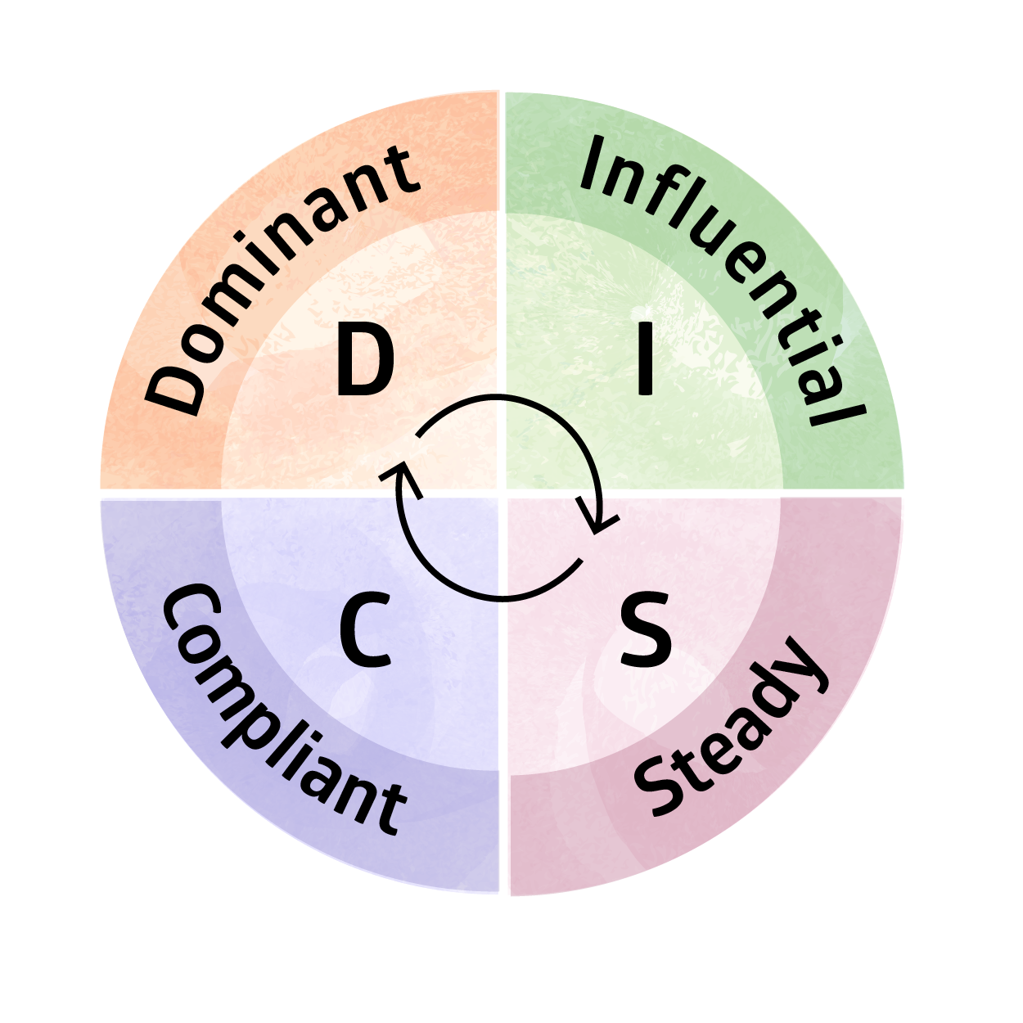
Group Activity 3
A Model for Adapting Your Communication Style
Ever wondered why people act or communicate the way they do?
DISC model stands for
Dominant
Influential
Steady
Compliant
People use a mix of communication styles but display one or two of the styles as “core”
Organization Logo
Notes:
FACILITATOR NOTES:
Ever wondered why people act or communicate the way they do?
The DISC model is a great tool that helps you understand both your behaviour and the behaviour of others. Based on the work of psychologist Dr. William Marston, this model enables you to predict certain behaviours and improve your interactions with everyone you meet.
The DISC model outlines four unique personality and behavioural traits that influence how you communicate:
D for Dominant
I for Influential
S for Steady
C for Compliant
People use a mix of communication styles but typically display one or two of the styles as their “core”.
No trait is better than another; they're just different.
By recognizing these traits in yourself and others, you'll enhance your communication and collaboration, whether with friends, family, or co-workers."
Let’s take a quick look into the 4 types of communication style outlined in the DISC model.

Slide 5
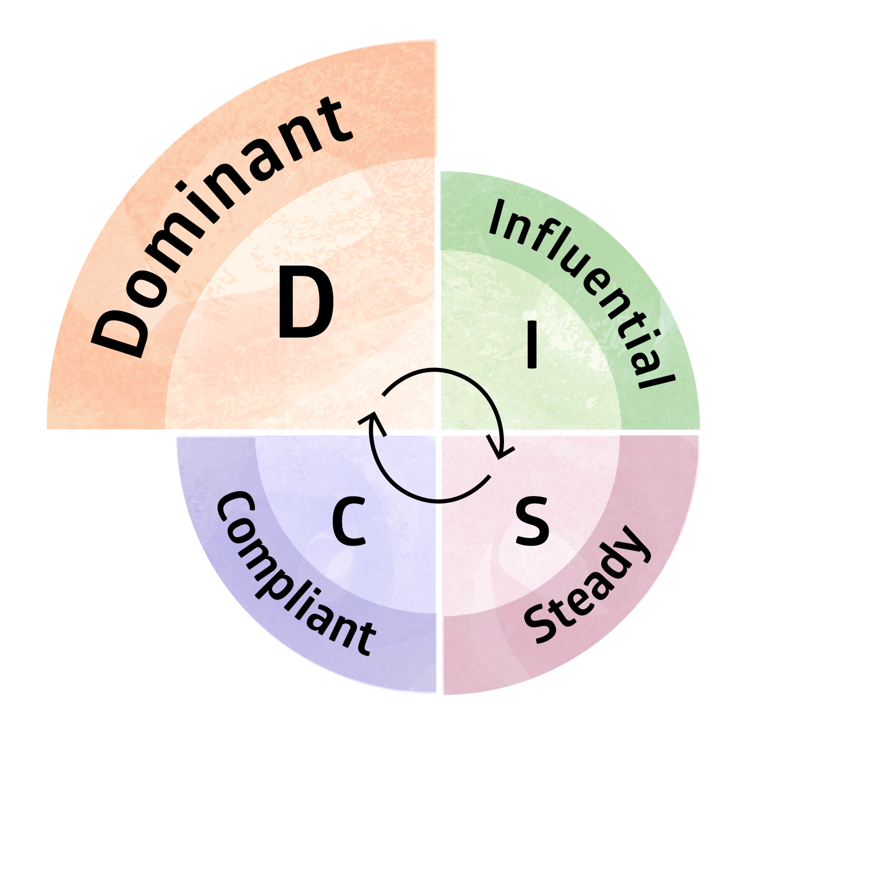
Group Activity 3
Dominant (D) Style Communicator
Dominant communication style is direct and decisive.
This type of communicator is self-confident, results-oriented and likes to take control of situations.
Communicating with a Dominant Style Communicator:
Be clear and brief
Provide facts
Be quick - Do not use idle chatter or tell long stories
Give them choices so they feel in control of the conversation
Be prepared and organized and get to the point quickly
17% of the population are Dominant Style communicators.
Organization Logo
Notes:
FACILITATOR NOTES:
The Dominant Communicator is often direct, decisive, and results-oriented. They like to move quickly, take risks, and see immediate results.
Dominant Communicators are very confident when they speak. They sometimes interrupt the conversation because they are eager to share their thoughts. They are comfortable leading group or team discussions.
You can spot a DOMINANT Communicator by:
Their confident manner of speaking.
Their tendency to interrupt, as they're eager to share.
Their initiative in taking the lead in groups.
Their habit of asking goal-oriented questions.
You can better communicate and connect with them by:
Stating points clearly and briefly—get to the business at hand.
Giving the facts - emphasize the results and what will be achieved by the conversation.
Being quick - avoid idle chatter or long stories.
Presenting them with choices that show they are in control of the conversation.
Being prepared and organized and getting to the point quickly.
Some examples of famous people who show a DOMINANT communication style:
Steve Jobs - The co-founder of Apple was known for his direct and uncompromising approach, often pushing his teams to meet very high standards and achieve specific, ambitious results.
Margaret Thatcher - The former Prime Minister of the United Kingdom, often referred to as the "Iron Lady," was famous for her firm and authoritative speaking style and her strong leadership.
Gordon Ramsay - The celebrity chef is well-known for his direct, no-nonsense demeanor in the kitchen, often leading with a high level of intensity and assertiveness.
Question: Do you know someone who is a DOMINANT Communicator?

Slide 6
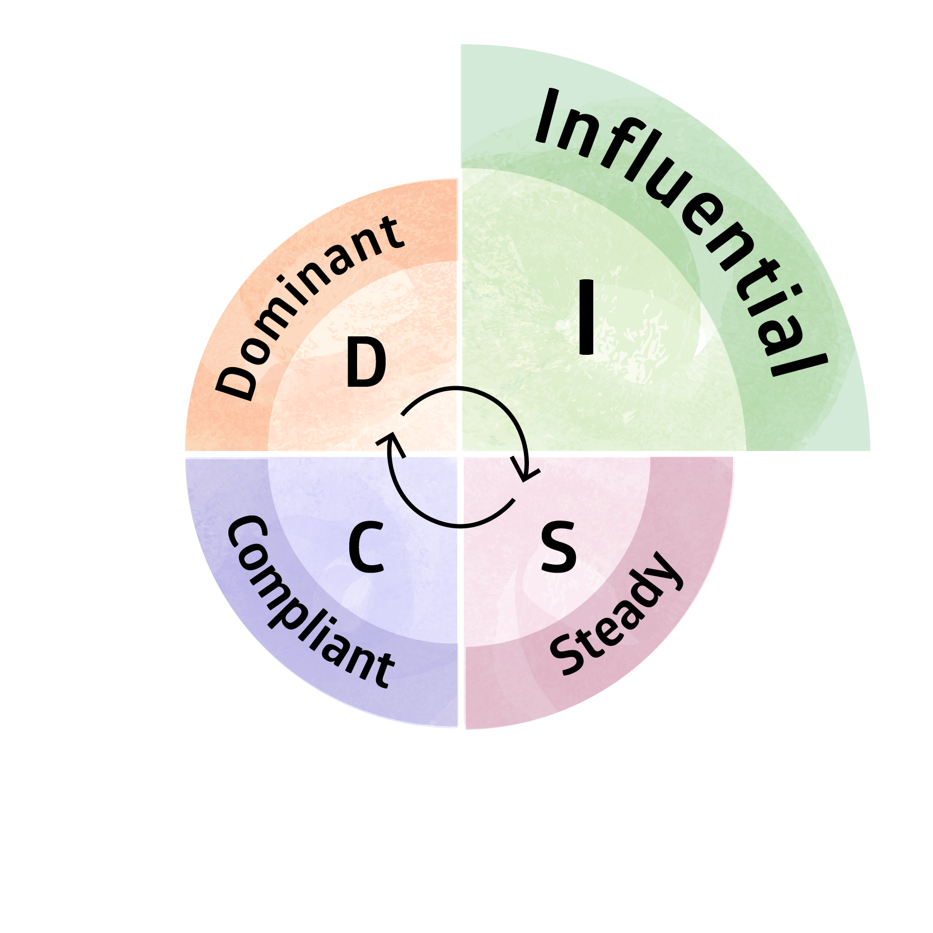
Group Activity 3
Influential (I) Style Communicator
Influential communication style is talkative, outgoing and motivated by interaction.
These individuals want to talk and must feel like they have been heard.
Communicating with a person who has an Influential communication style:
Be friendly and sociable
Ask for their opinion
Let them talk and share their thoughts
Ask specific questions if you want specific answers
38% of the population are Influential Style communicators.
Organization Logo
Notes:
FACILITATOR NOTES:
Individuals with the Influential (I) style are talkative, sociable, optimistic, and lively.
They are people-oriented; they want to engage and share their stories and feel like they are really heard.
You can identify an INFLUENTIAL communication style by:
Their animated and enthusiastic gestures
Their inclination to share personal stories
Their natural role at the center of social interactions
Connect with them by:
Engaging in friendly conversations
Maintaining a positive attitude
Relating through stories or examples
Some examples of famous people who show an INFLUENTIAL communication style
Oprah Winfrey - Known for her empathetic and engaging communication style, Oprah connects deeply with her audience, making her a quintessential example of an Influential communicator.
Barack Obama - His charisma and ability to connect with diverse audiences through storytelling and persuasive speeches are hallmark traits of an Influential communicator.
Question: Do you know someone who is an INFLUENTIAL Communicator?

Slide 7
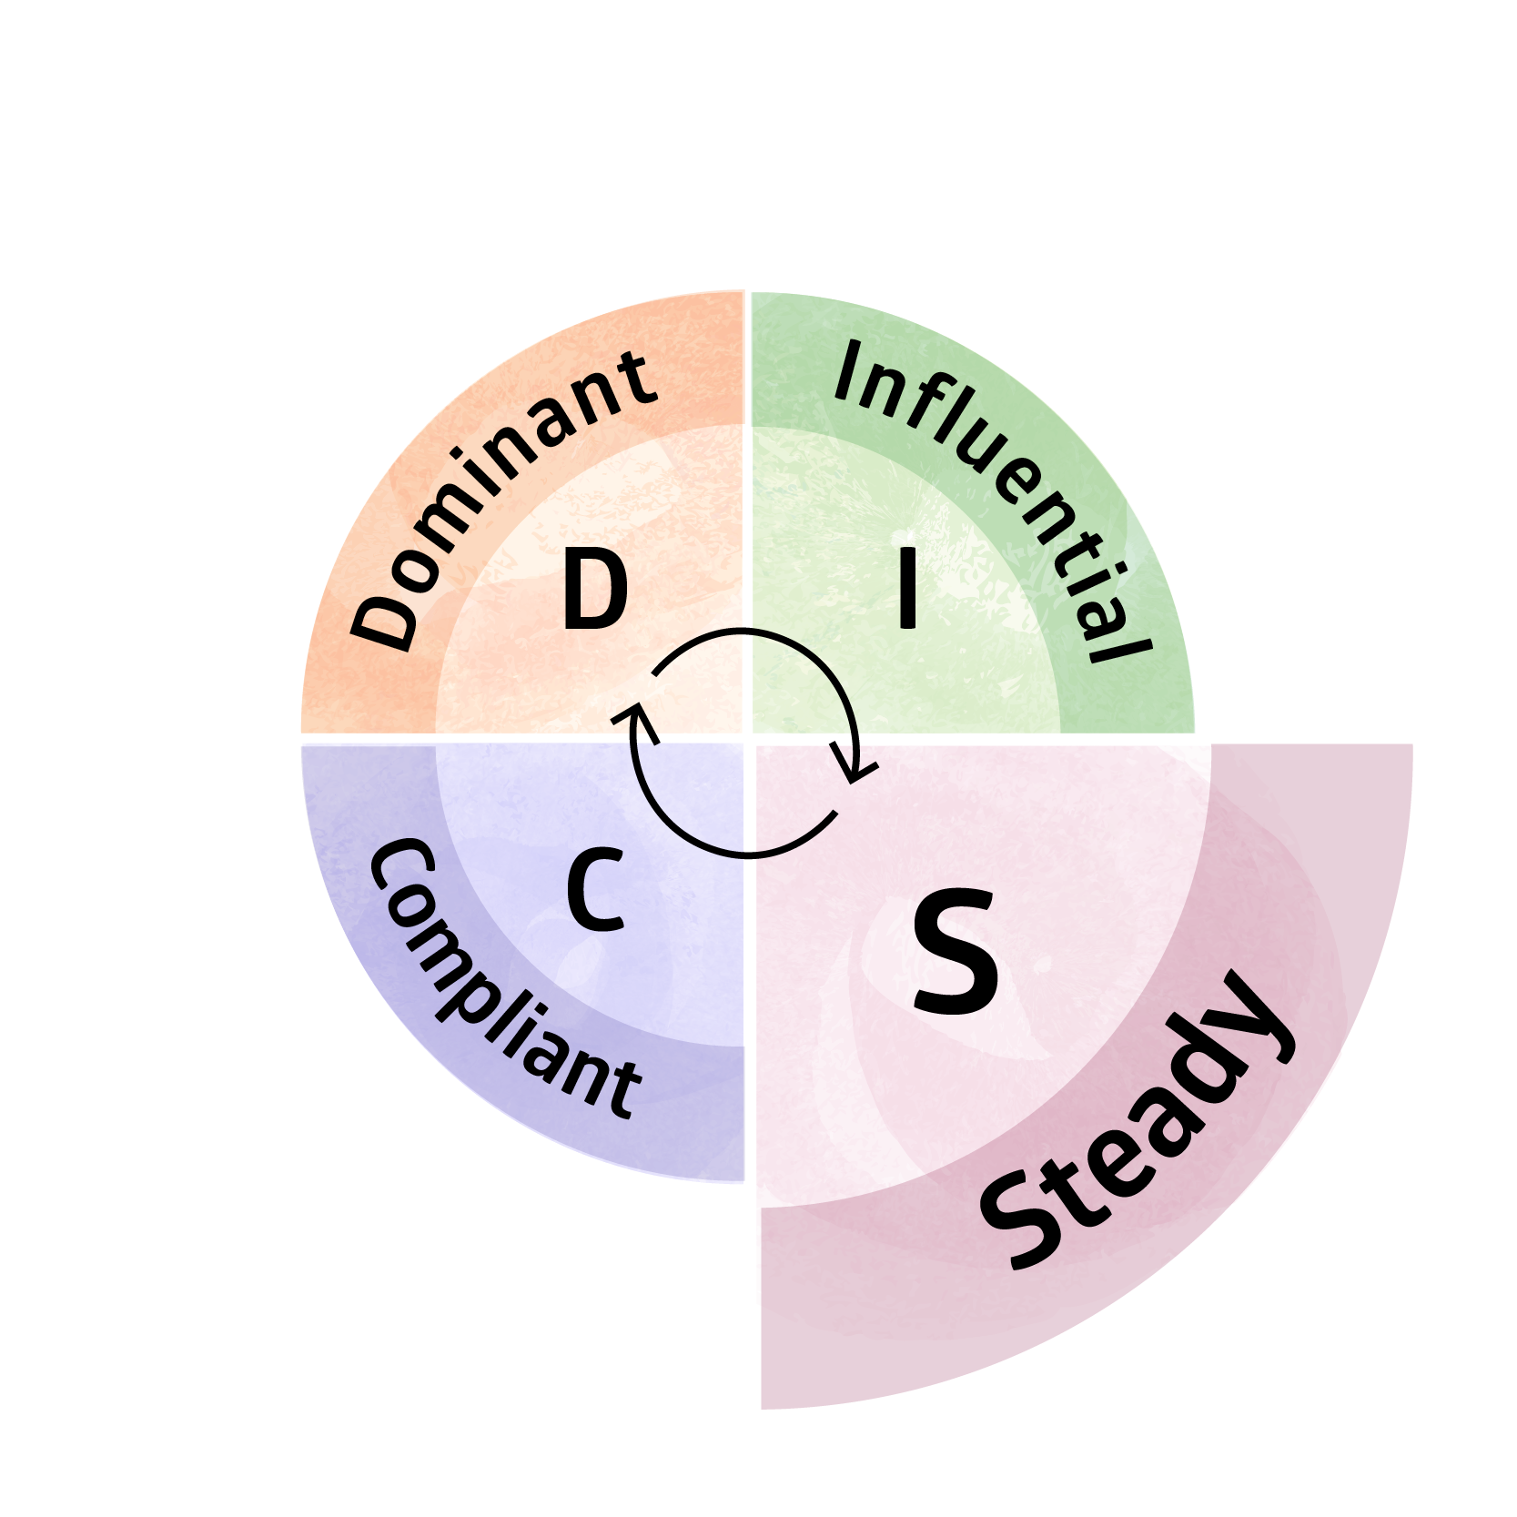
Group Activity 3
Steady (S) Style Communicator
Steady communication style is calm and patient.
This type of communicator prefers listening over talking, and sharing feelings.
Communicating with a Steady Style Communicator:
Let them share their feeling and be open to sharing your emotions too
Show you are sincere and interesting in what they are saying
Provide reassurance about possible changes
Use your active listening skills – ask questions
32% of the population are Steady Style communicators.
Organization Logo
Notes:
FACILITATOR NOTES:
Steady style communicators represent approximately 32% of the global population.
They are often calm, patient, and laid-back, and are seen as attentive listeners.
You can identify them by:
Their calm approach in conversations
Their preference for listening over speaking
Their tendency to avoid conflicts
Their questions about how you are feeling or how they can help
You can communication with them by:
Being open about your feelings and sharing them in the conversation
Not rushing the conversation and showing them you are sincere
Providing them with reassurance about changes, as steady style communications are often resistance to new ideas or changes
Showing you are engaged by practicing your active listening skills
Some examples of famous people who show a STEADY communication style
Dr. Bonnie Henry - The Provincial Health Officer for British Columbia, Dr. Henry has gained national recognition for her "Be Kind, Be Calm, Be Safe" mantra during the COVID-19 pandemic. Her empathetic and soothing communication style has helped guide the province through the crisis with clarity and compassion.
Jimmy Carter - The former U.S. President is known for his gentle and thoughtful communication style. Even after his presidency, Carter's work with humanitarian efforts and his diplomatic endeavors reflect his steady and compassionate approach to communication and leadership.
Question: Do you know someone who is a STEADY Communicator?

Slide 8
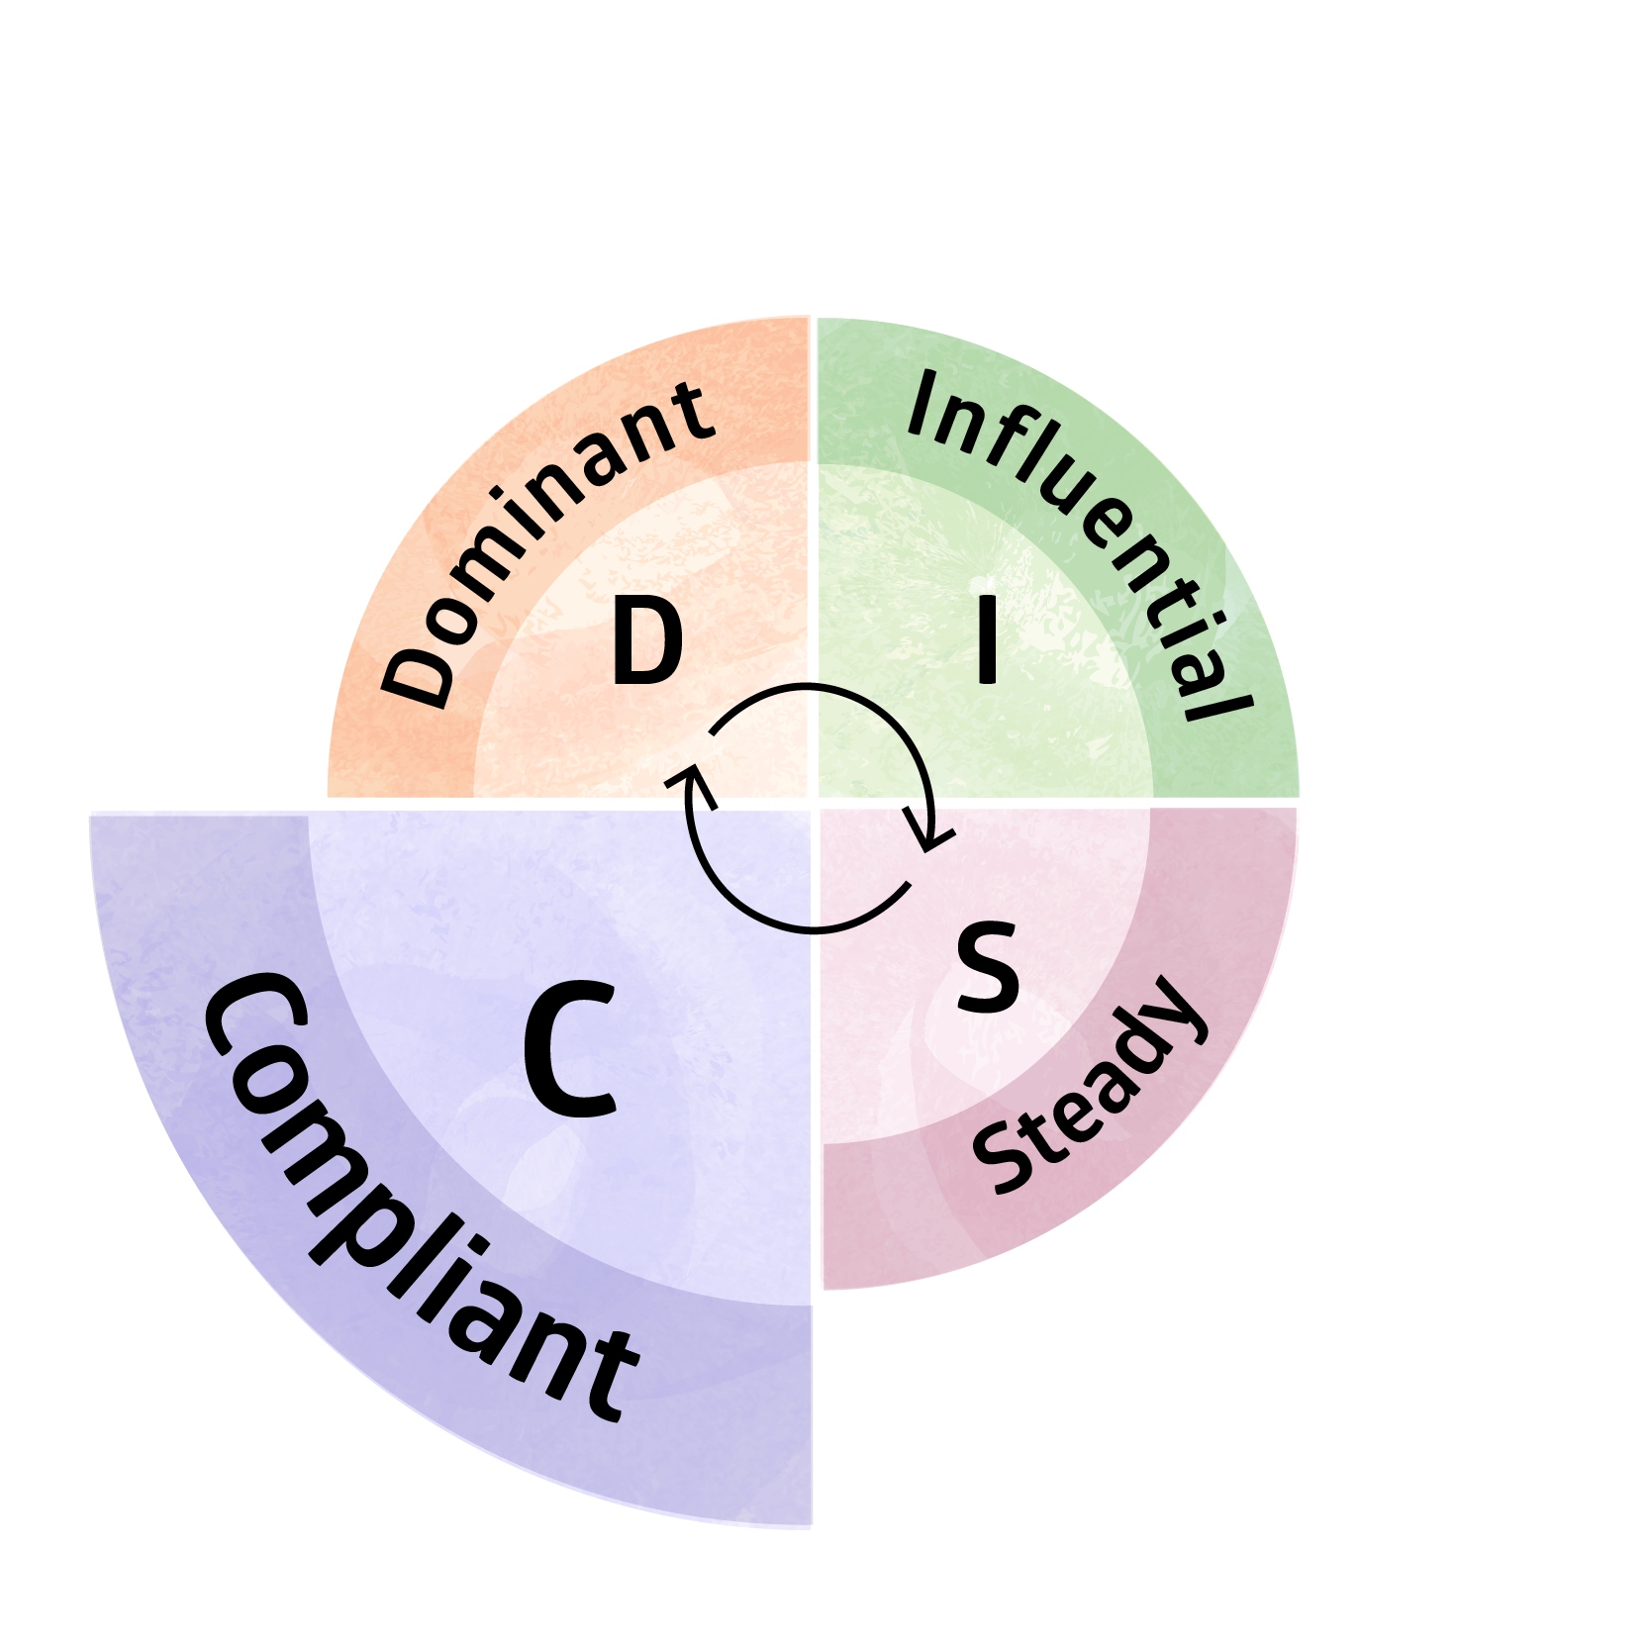
Group Activity 3
Compliant (C) Style Communicator
Compliant communication style is precise, logical, and analytical.
This type of communicator likes structure and rules.
Communicating with a Compliant Style Communicator:
Provide details and reasons why
Be precise and organized
Share evidence or data if available
13% of the population are Compliant Style communicators.
Organization Logo
Notes:
FACILITATOR NOTES:
Compliant style communicators are precise, logical, and analytical.
They thrive in environments with lots of structure and clear rules.
You can identify them by:
Their need to ask lots of questions
Their deliberate approach to conversations
Their preference for organized discussions
Their need to clearly understand the issue and options
You can connect with them by:
Offering detailed information and rational
Giving information in a precise and organized way
Sharing evidence and taking the time to provide data or rational explanations
Some examples of famous people who show a COMPLIANT communication style
Bill Gates - As the co-founder of Microsoft, Gates is renowned for his detail-oriented and analytical approach to problem-solving and his focus on data-driven decisions, which aligns well with the characteristics of a Compliant communicator.
Angela Merkel - The former Chancellor of Germany is known for her meticulous and structured approach to leadership. Her background in quantum chemistry and her methodical, data-focused decision-making process are hallmark traits of a Compliant communication style.
Question: Do you know someone who is a COMPLIANT Communicator?

Slide 9
Group Activity 3
Exercise
 | Dominant (D) | Influential (I) | Steady S) | Compliant (C)
1. When receiving information, you prefer it to be: | Concise and to the point | Engaging and persuasive | Warm and personable | Detailed and accurate
2. In conversations, you are: | Assertive and commanding | Lively and storytelling | Gentle and understanding | Precise and questioning
3. When making decisions, you rely on: | Quick judgements & efficiency | Intuition and the opinions of others | Consensus and the impact on people | In-depth information and analysis
4. The data you need to feel informed is: | High-level summaries | Testimonials and case studies | Feedback from others | Complete and comprehensive data
5. Your style of talking with others is typically: | Direct and forceful | Animated and expressive | Attentive and supportive | Deliberate and cautious
Total | D: | I: | S: | C:
Organization Logo
Notes:
FACILITATOR NOTES – SELF-REFLECTION EXERCISE
Let’s take a moment now to think about our own communication styles through this short guided self-assessment.
This tool, adapted for the D.I.S.C. model, includes several statements that describe:
How a person likes to receive information
How they behave in conversations
How they process information and make decisions, and
How they verbally speak with others.
Reflect on each statement and consider if it describes the way you like to communicate.
Give your first choice 2 points and your second choice 1 point.
Remember, you will often use more than one style of communication when you are interacting with others.
(PAUSE and allow group to complete)
Scoring Add up your scores and think about what style of communicator you are. Do you know any other people who have a similar style?
Optional - (You can ask the group if anyone would like to share any AH-HA moments—remember, there are no wrong answers. If no one wants to share, move on.)"

Slide 10
Group Activity 3
Using EI skills and adapting your communication style helps you to better understand and empathize with patients and their families, leading to improved trust, more accurate diagnoses, and adherence to care plans.
Being heard and understood is a fundamental human need, as essential as the air we breathe.
Organization Logo
Notes:
FACILITATOR NOTES:
[Note –If you want you can read the slide before final wrap up words]
[WRAP UP]
Adapting your communication style using the DISC model can help you be better understood, and engage your patients, their families, and other members of the healthcare team when providing home-based palliative care.
Remember, people communicate differently.
They speak and process information in various ways, and it is important that you adapt your style to better convey your messages and create stronger relationships.
Good conversations are more than just words; they're about really connecting with someone.

