Slide 1
Emotional Self-Awareness and Mindfulness
Group Activity 1
Developing the Attitude to provide a Palliative Approach to Care
Organization Logo
Notes:
FACILITATOR NOTES:
In this 10-minute group activity, you will:
Reinforce your understanding of emotional intelligence and why it is so important when providing palliative care.
Discuss emotional self-awareness and reflect this EI skill and how it fosters a holistic approach to patient care.
Practice mindfulness, a behaviour you can do every day to develop your emotional self-awareness.

Slide 2
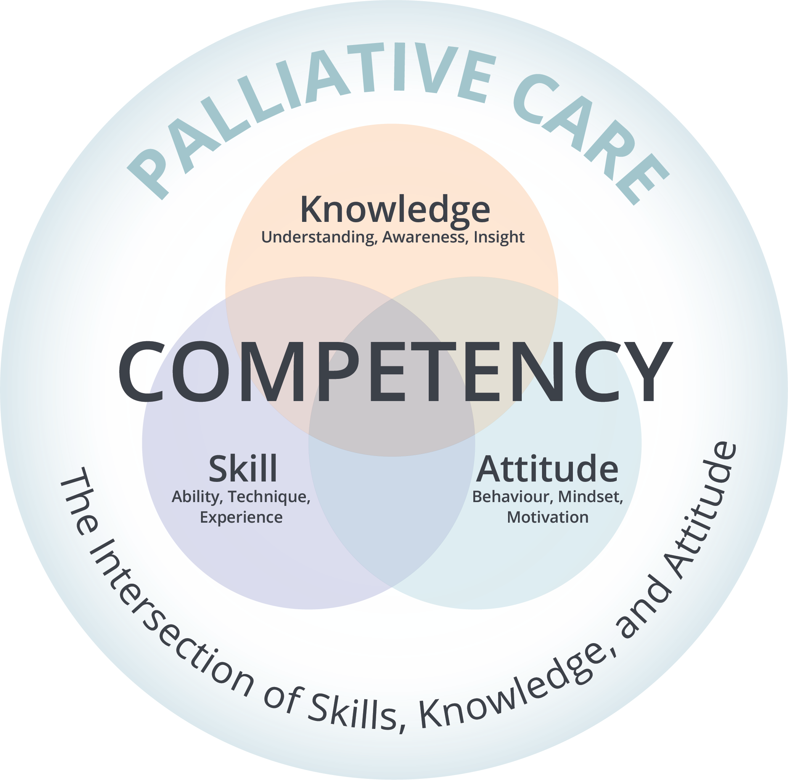
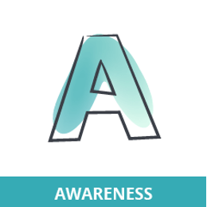
Group Activity 1
Emotional Intelligence (EI) and Palliative Care
Highly emotional situations when dealing will illness and end-of-life issues.
EI helps you validate your emotions and those of others.
Using EI you can recognize patients’ holistic needs – how they feel, their concerns, fears and anxieties.
The ABCs of Emotional Intelligence
Each healthcare position requires a specific set of competencies, and particularly human resources for employees to function adequately, and EI plays a substantial role among these.
https://www.ncbi.nlm.nih.gov/pmc/articles/PMC7520462/#cit0011l
Understand and manage emotions
Balance positive and negative emotions
Acknowledge emotions and practice empathy
Organization Logo
Notes:
Emotional intelligence plays a pivotal role when caring for patients receiving palliative care and their families, where you may encounter highly emotional situations.
Using emotional intelligence skills enables you to view patients holistically, recognizing the interconnectedness of various aspects of care. This perspective is fundamental when providing a palliative approach to care.
The ABCs of Emotional Intelligence:
An easy way to remember the core elements of emotional intelligence is to think about the A-B-Cs for EI.
Awareness – Be aware of your own emotions and those of others. How do you feel right now and why? Remember that emotions impact our thoughts and actions, so being aware of them is critical when you need to respond thoughtfully to situations, rather than reacting impulsively.
Balance - Try to maintain a balance in your emotions. Don’t let any single emotion - positive or negative - overpower you. Practice emotional balance so that you can respond to situations and people more effectively and appropriately.
Compassion – Try to understand not only your feelings but those of others. As health care providers we do this very well, however it is important to make sure you don’t unconsciously take on the emotional pain and stress of their patients. This can happen in high-empathy environments like palliative care, where you are regularly exposed to suffering, grief, and death.

Slide 3
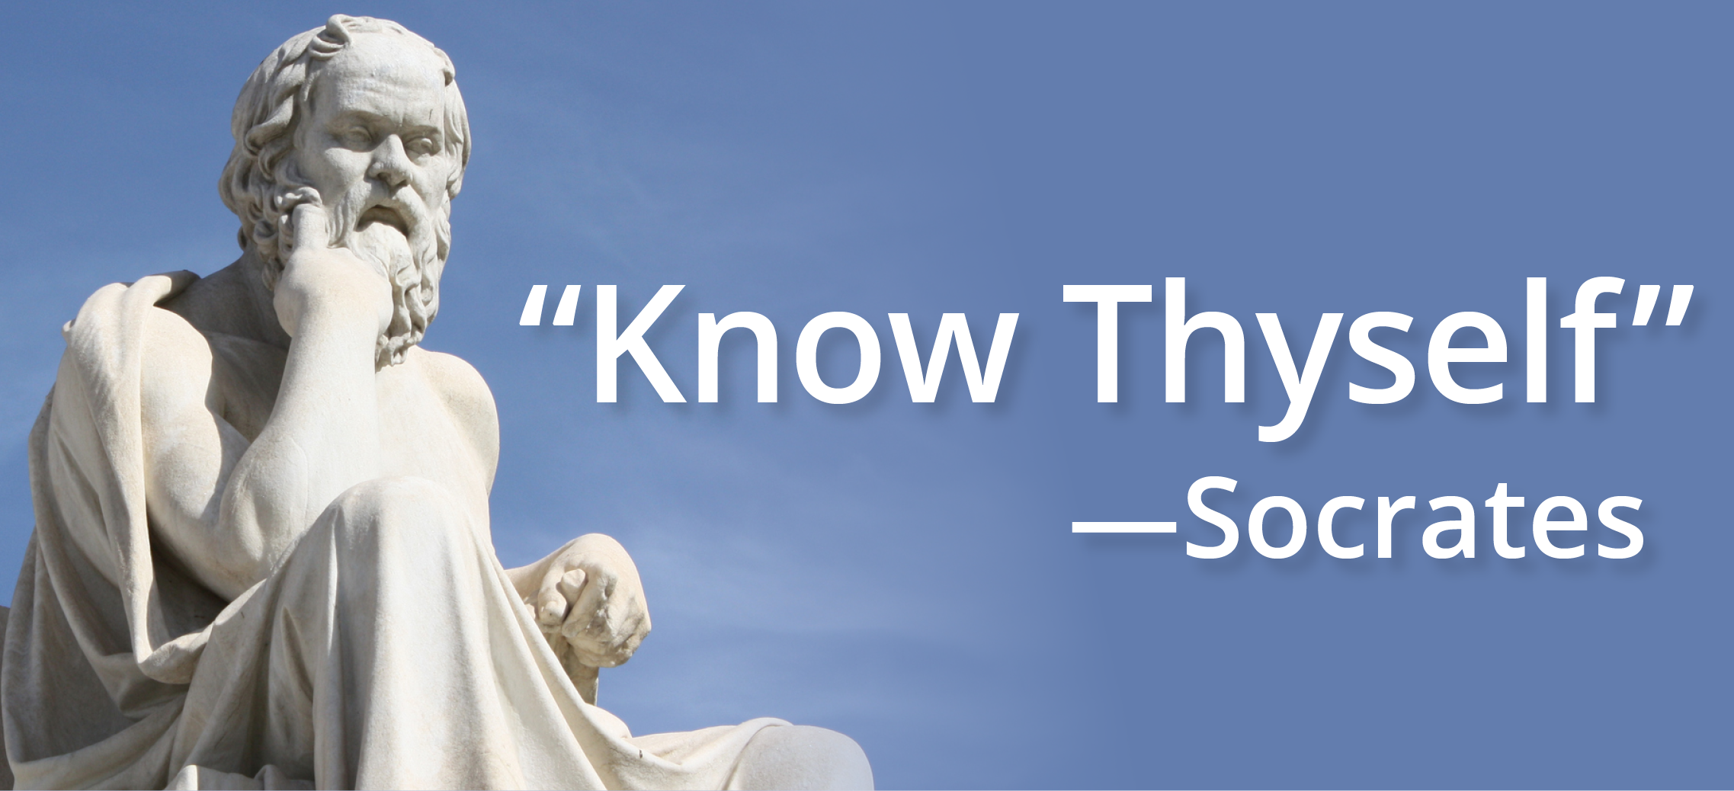
Group Activity 1
The EI Skill – Emotional Self-Awareness
Emotional self-awareness is our ability to be aware of and understand our feelings and behaviours, and the impact they have on others.
It means we know why we are thinking and acting in certain ways.
Self-awareness helps us understand how we are influencing the emotions and actions of others.
“95 percent of people think they’re self-aware, but only 10-15 percent actually are.”
(Eurich, 2018)
Organization Logo
Notes:
Facilitator NOTES
Emotional Self-awareness is your ability to notice and understand your emotions and actions and see their impact on others around you.
It's crucial to be aware of how your feelings and behaviours affect those in your care. If you are angry and frustrated, are your actions reflecting this and making others mad too?
Engaging in continuous self-reflection and improvement is key to enhancing your emotional intelligence skills. Once you grasp why you think and act as you do, you're in a better position to decide how and if you should change.
FUN FACT:
Long before EI was formally recognized in the psychological lexicon, ancient philosophers like Socrates, Plato, and Aristotle were discussing virtues such as emotional self-awareness, self-regulation emphasizing the importance of mastering one's passions and understanding others. It's fascinating to think that discussions around the dinner tables of ancient Greece laid the groundwork for a concept that would become a major field of study thousands of years later.

Slide 4
Group Activity 1
Exercise
 | Strongly agree (4 points) | Somewhat agree (3 points) | Somewhat disagree (2 points) | Strongly disagree (1 point)
1. I can describe my emotions in the moment I experience them.
2. I am good at understanding where others are coming from when they are really upset.
3. I’m aware of what might trigger my emotions or reactions.
4. I can easily tell the difference between similar emotions, such as fear, apprehension, and concern.
5. I’m aware of the effect what I do or say has on others.
6. I can usually pinpoint exactly why I reacted a certain way.
7. I’m comfortable speaking to others about their emotions and feelings.
TOTAL SCORE
Adapted from the Workplace Strategies for Mental Health EI Assessment Tool https://www.workplacestrategiesformentalhealth.com/resources/emotional-intelligence-methodology
Organization Logo
Notes:
.
FACILITATOR NOTES – SELF-REFLECTION EXERCISE
Let’s take a moment now to assess our emotional self-awareness through this guided self-assessment.
This tool, adapted from the Workplace Strategies for Mental Health EI Assessment Tool, includes several statements that you'll rate from 'strongly agree' to 'strongly disagree.’
Reflect on each statement, such as 'I can describe my emotions in the moment I experience them,’
I encourage you to answer honestly.
Once you are done, add up your total score and reflect on the areas that you can grow and strengthen your emotional intelligence.
(PAUSE and allow group to complete)
SCORING
26 and above: High level of self-awareness.
You recognize your emotions, the causes and impact of your emotions.
18-25: Moderate level of self-awareness. Think about emotional intensity and triggers. Practice mindfulness every day.
17 or less: Low level of self-awareness. Self-awareness if the core of emotional intelligence. Remember with knowledge and practice you can increase your self-awareness. Reflect on your emotions and practice mindfulness every day. Recognize emotional intensity and triggers. Think about how you manage and use your emotions.
Optional
(You can ask the group if anyone would like to share any AH-HA moments – REMEMBER no wrong answers. If no one wants to share move on)

Slide 5
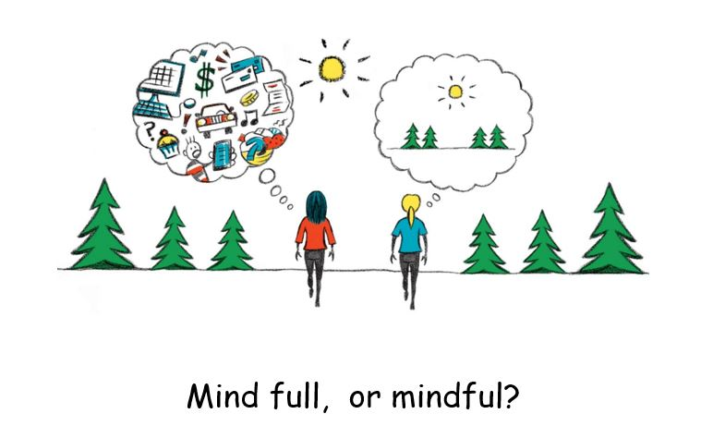
Group Activity 1
Developing Your Emotional Self-Awareness through Mindfulness
Mindfulness is being consciously aware of our inner thoughts, feelings, and surroundings, without judgement.
Practicing Mindfulness
Lowers stress
Decreases negative emotions
Improves focus and memory
Helps solve problems
Builds Emotional Self-Awareness
Organization Logo
Notes:
FACILITATOR NOTES :
Mindfulness is about being fully present in the moment, aware of our thoughts, feelings, and surroundings without judgment.
Have you ever found yourself lost in thought, replaying past conversations or worrying about the future? (PAUSE - let group reflect for a minute )
Mindfulness brings our attention back to the now, helping us focus on what's happening in the present. Let's explore how mindfulness can become a powerful tool in enhancing our emotional intelligence."
Practicing mindfulness comes with a wealth of benefits.
It can lower stress levels, reduce overthinking, decrease negative emotions like anxiety and depression, and improve our emotional regulation.
Mindfulness sharpens our focus and enhances our cognitive flexibility.
As we become more mindful, we also enhance our self-awareness, allowing us to better understand and manage our emotions in healthy ways.

Slide 6
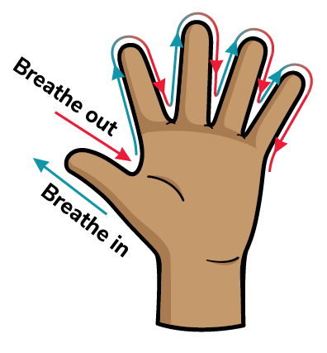
Group Activity 1
Finger Breathing for Mindfulness
From Cedars-Sinai.org
Organization Logo
Notes:
FACILITATOR NOTES:
Let’s take a minute to practice a technique called 5 Finger Breathing.
Five-finger breathing is a quick and easy breathing exercise to find balance and mindfulness.
[ GO VERY SLOWLY THROUGH THE INSTRUCTIONS]
Okay everyone…
Hold one hand out.
With your other hand, starting at your thumb trace each finger up as you slowly breathe in and trace each finger down as you slowly breathe out.
Slowly breathe in going up
Slowly breath out going down
And continue
Finish with five deep breaths.
When you're done, use your other hand and repeat the exercise.
[you can ask participants how this made them feel – if time]

Slide 7
Group Activity 1
Research has shown that doctors, nurses, and other healthcare professionals with high levels of emotional intelligence tend to have better patient outcomes. This is because EI enables health care providers to better understand and empathize with patients and their families, leading to improved trust, more accurate diagnoses, and adherence to treatment plans.
Patients may not always remember the exact medical advice given, but they'll remember how their healthcare provider made them feel, influencing their overall satisfaction and engagement in their care.
The production of this material has been made possible through a financial contribution from Health Canada. The views expressed herein do not necessarily represent the views of Health Canada.
Organization Logo
Notes:
FACILITATOR NOTES:
[Note –If you want you can read the slide before final wrap up words]
[WRAP UP]
To wrap up, we've explored:
the critical role of emotional intelligence in palliative care.
the EI skill of Emotional Self-Awareness and why it is important to recognize your own emotions, and
how practicing mindfulness can help develop your emotional self-awareness and help you recognize how you are feeling and manage your actions.
Remember the ABC’s of Emotional Intelligence
Awareness – Be aware of your own emotions and those of others and recognize how they impact throughs and actions.
Balance – Maintain a balance in your emotions.
Compassion – Understand what your patients and their families are feeling but don’t unconsciously take on their emotional pain and stress.
Finally – remind yourself to be mindful of your emotions and thoughts throughout the day. Give yourself “a hand” and “take 5”.

