Slide 1
Team–Based Care Enabling Diverse Teams to Collaborate
2017 Home Care Summit
Tom Carter
Director of Clinical Education
CBI Health Group

Slide 2
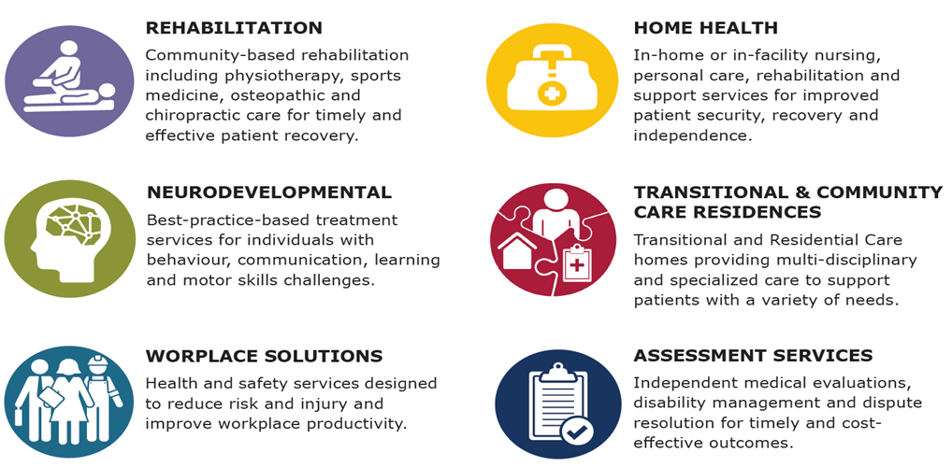
CBI offers a suite of solutions

Slide 3
My mandate is Clinical Education and Research – Not business operations
Leveraging a talent rich and diverse group of clinical teams
Provide seamless care across settings
“People like you” – clustering expertise
Relationships – network wide
Link to external stakeholders
Data driven decision making

Slide 4
My Journey
Been in role for 18 months
Started with teams that existed in a number of business units – fewer than 20 education leads
Have built to 60 education leads with teams enabling all segments of services

Slide 5
Teams are organized in a hub and spoke model
Home Health
Team Function
Neuro- developmental
Rehab Clinics
Director of
Clinical Education
Residential and Transitional Living

Slide 6
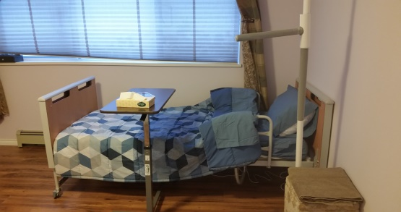
Diverse Team-Based Care
An integrated approach that emphasizes collaboration
Patients with complex needs

Slide 7
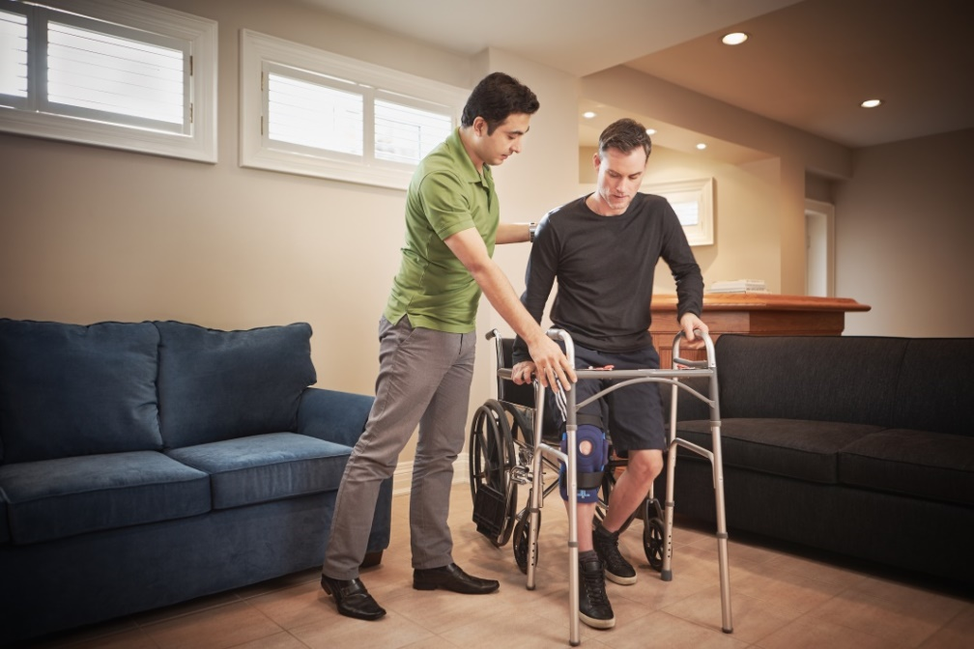
Diverse Team-Based Care
An integrated approach that emphasizes collaboration
Patients with complex needs

Slide 8
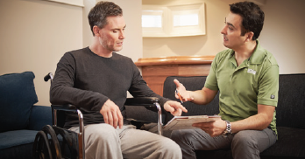
Diverse Team-Based Care
An integrated approach that emphasizes collaboration
Patients with complex needs

Slide 9
Diverse Team-Based Care
An integrated approach that emphasizes collaboration
Patients with complex needs

Slide 10
Components of Building a Network Wide Clinical Education Function
Talent
Awareness
Knowledge Sharing
Value Creation
Building a Community

Slide 11
The Education Collaboration Challenge
Challenges
Educational content
Actions
Senior leadership team support
Education strategy
Creation of a collaborative learning environment
Gatekeepers: Business Leaders, Subject Matter Experts, Policies and Procedures, IT
Clinical Data Capture
Timely access to education

Slide 12
Talent Attraction and Development are Critical
What we are doing
Recruitment program for key suites of services
Promoting CBI as a preferred employer of clinical talent
Opportunities to work with Subject Matter Experts on key projects
Opportunities to move between teams
Learning Circle – curated content and collaborative learning
Peer to Peer skills training

Slide 13
Raising Awareness of Collaborative Education
Senior level and clinicians
Internal town hall presentations
Ongoing engagement with business leaders

Slide 14
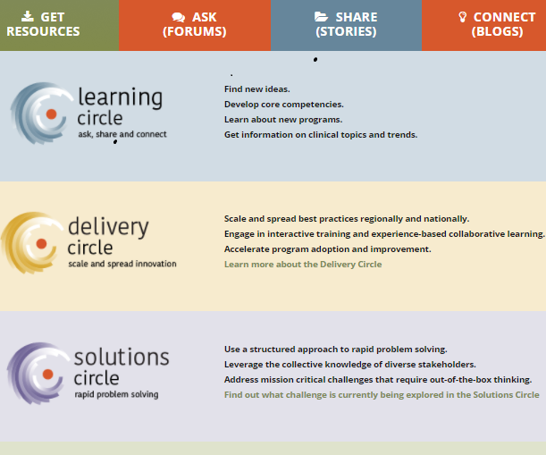
Knowledge Sharing
Best practice meetings
Clinical education leadership team
Cross functional working groups – Delivery Circles
Virtual internal education conferencing

Slide 15
Value Creation
Focused on value enablement although not all initiatives create measurable value
Some satisfy strategic or tactical goals
Focuses efforts on education initiatives that create value and also on time to value
Collaborative learning creates value in partnership with other functions

Slide 16
Building a Community
Learning Circle
Collaboration forums
Cross functional working groups
Best practices
Celebrating success

Slide 17
Thank you

