Slide 1
Building Blocks for Successful Integration of Services Across Sectors and Professions:
International Evidence and Experience
Canadian Home Care Association 2017 Home Care Summits
Dr Viktoria Stein
Director of Education and Training
International Foundation for Integrated Care

Slide 2
The International Foundation for Integrated Care
IFIC is a non-profit members’ network that crosses organisational and professional boundaries to bring people together to advance the science, knowledge and adoption of integrated care policy and practice.
The Foundation seeks to achieve this through the development and exchange of ideas among academics, researchers, managers, clinicians, policy makers and users and carers of services throughout the World.
IFIC’s portfolio includes the International Journal for Integrated Care (IJIC), the ICIC and WCIC conferences, the Integrated Care Academy© and a strong members platform.

Slide 3
A little reminder of why we are here…
Notes:
Short intro of each participant on what integrated care is to them, according to their professional background/setting/country of origin…
Main achievements and biggest challenges again in their context.
Participants from the same country should add to each others’ stories.

Slide 4
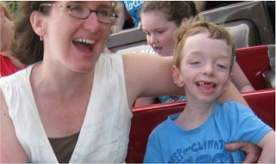
Courtesy of Prof. Richard Antonelli, Boston Children’s Hospital, Harvard Medical School

Slide 5
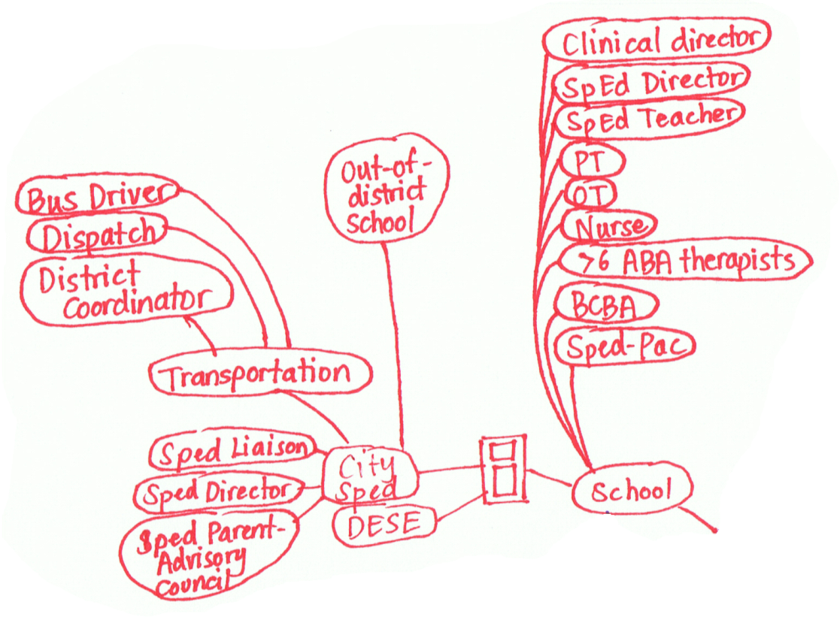
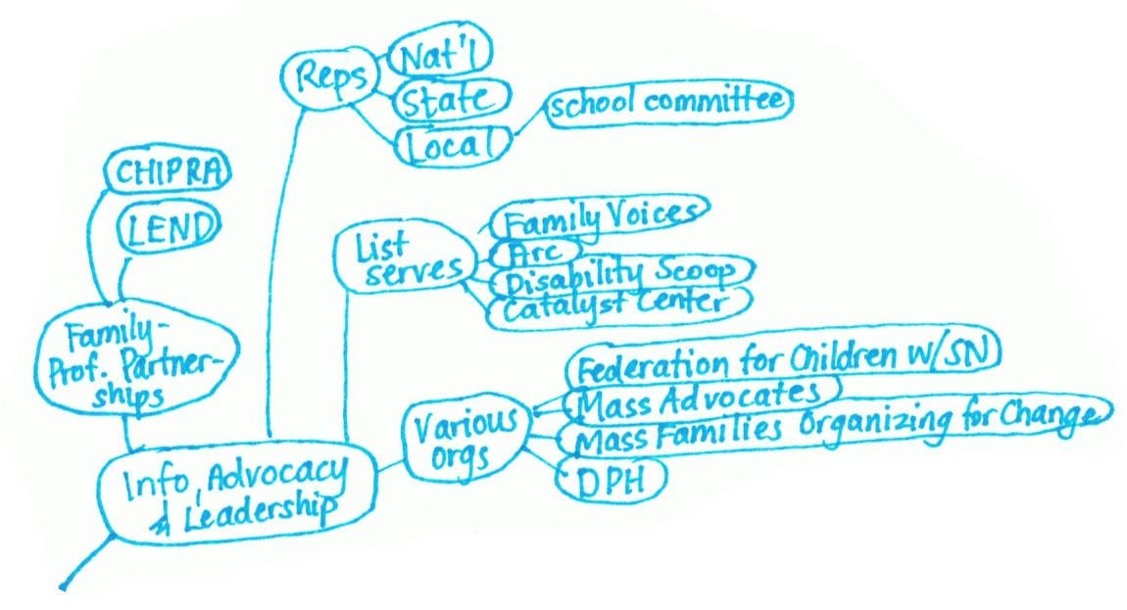
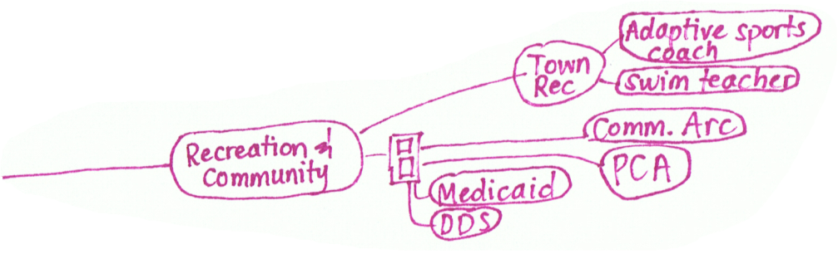

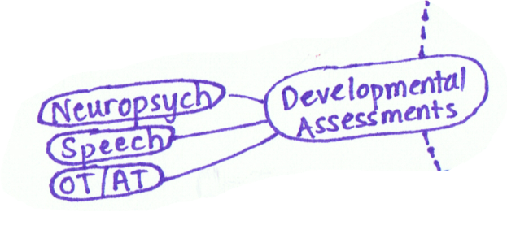
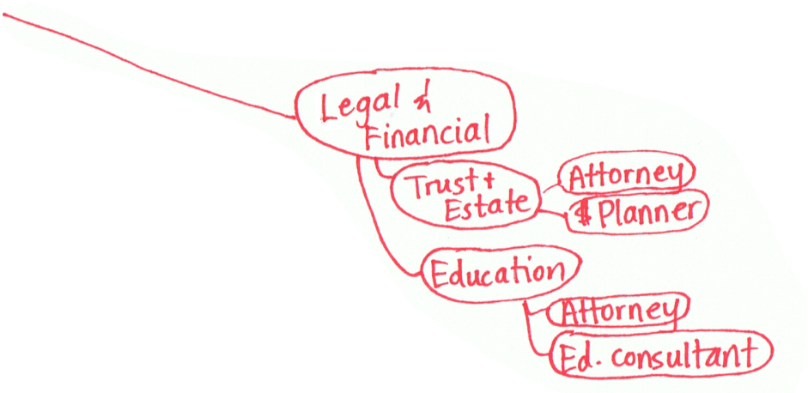
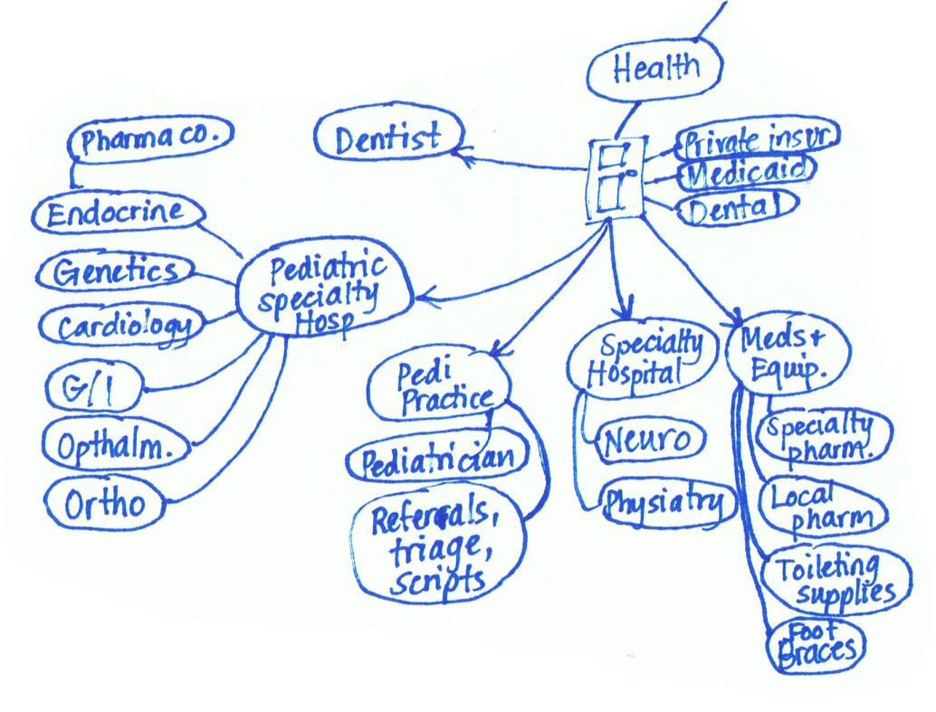
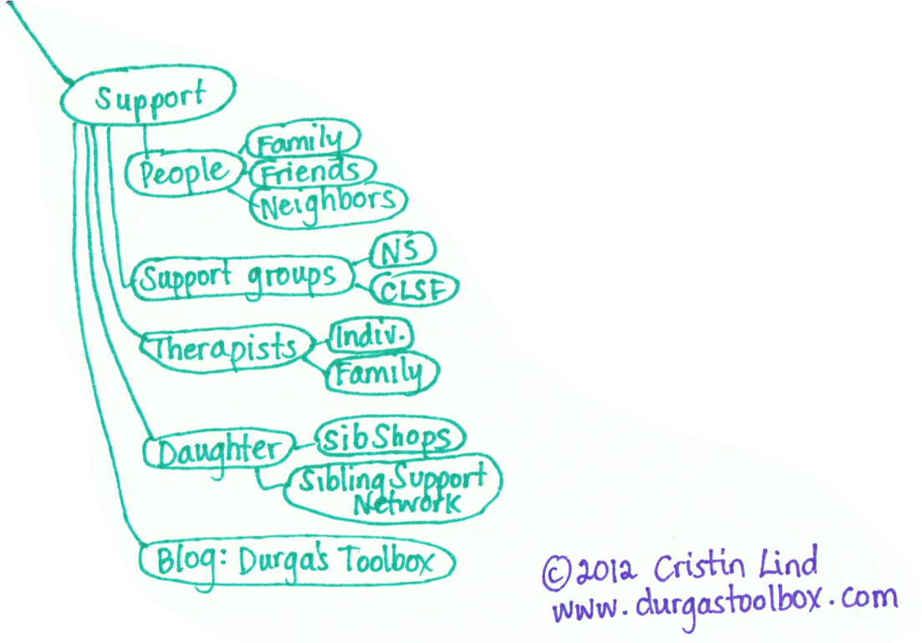
Gabe’s map of care
www.childrenshospital.org/care-coordination-curriculum/care-mapping
Notes:
One Family's Care Map: The Picture that Tells a Thousand Words
Health care system is FRAGMENTED!!
If this slide resonates with you and you’d like to use it in any context, please contact Cristin Lind directly to get permission and the most updated version:
caclind@gmail.com
Links with background context on this Care Map:
1) in BCH CC Curriculum materials: www.childrenshospital.org/care-coordination-curriculum/care-mapping (see also Health Affairs video)
2) http://durgastoolbox.com/2012/09/19/durga-tool-9-my-care-map-or-the-picture-that-tells-a-thousand-words/
3) Lisa Belkin at the Huffington Post interview and video:
http://www.huffingtonpost.com/2013/01/18/gabes-care-map-special-needs-children-caregivers_n_2469564.html?utm_hp_ref=parents&ir=Parents
Original release: Jan. 18, 2013. The full video of Cristin and Rich’s interview online (CHECK in case link changed): http://live.huffingtonpost.com/r/segment/what-it-takes-to/50f97e3dfe34447bd30002f3

Slide 6

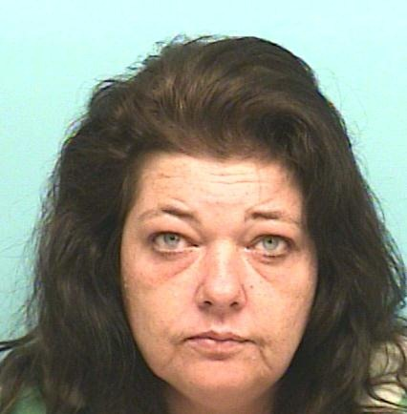
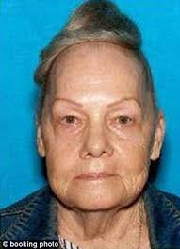

Supporting families
Zac, 8
ADHS
Problems at school
Problems making friends
No regular GP visits
Sandra, 46
Irregular employment
Mental health issues, self harm
Smoker
DM Type II
Dorothy, 65
Minimum pension
DM II
Hypertension
Hip replacement
COPD
Stella, 10
No regular GP visits
Healthy?
Courtesy of Dr Dan Ewald, North Coast PHN, NSW, Australia

Slide 7
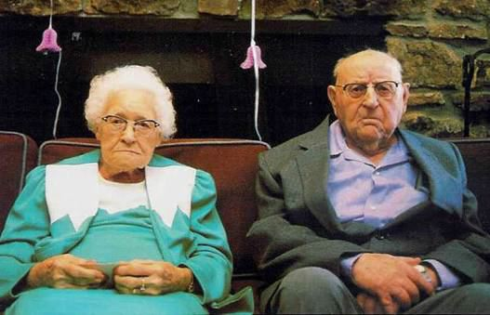
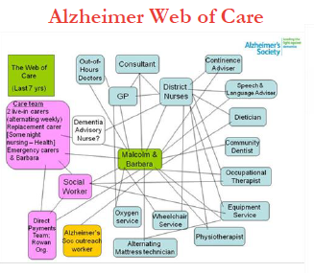
Designing Better Care for
Malcolm and Barbara
Frontier Economics (2012) Enablers and barriers to integrated care and implications for Monitor

Slide 8
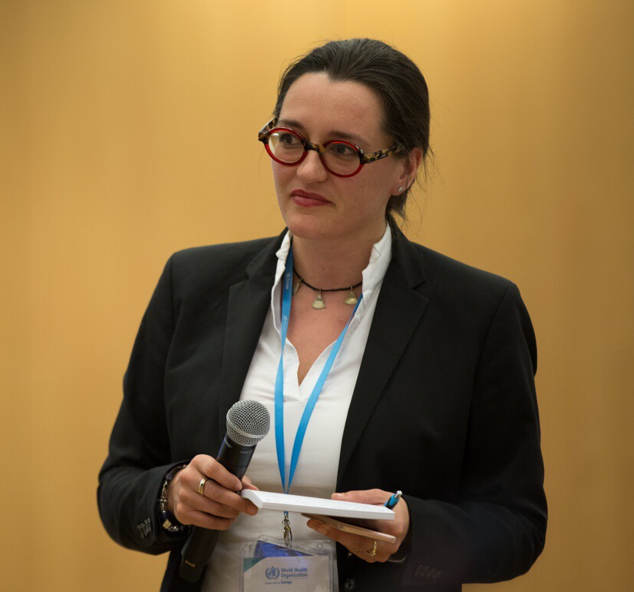
And then there’s me and YOU

Slide 9
The Kaiser Triangle
Source: Amelung 2012, based on Singh and Ham, 2006

Slide 10
So, if we are all doing our best, why don’t we provide holistic, people-centred care?
Notes:
Short intro of each participant on what integrated care is to them, according to their professional background/setting/country of origin…
Main achievements and biggest challenges again in their context.
Participants from the same country should add to each others’ stories.

Slide 11
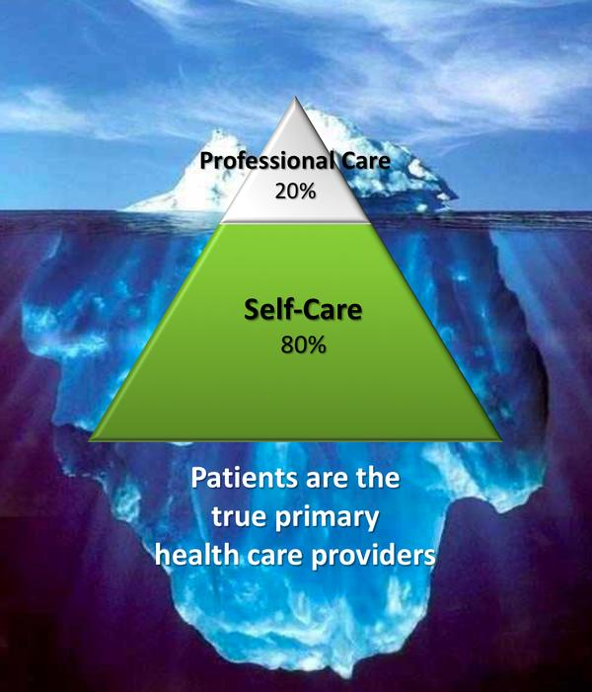
The reality of care settings
Need for people engagement
Need for patient empowerment
Hours with professional / NHS = 3 in a year
Hours of self care = 8757 in a year
Adapted from Goodwin 2008 and 2014

Slide 12
And where are the social services?

Slide 13
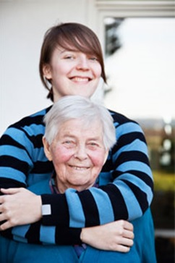
The situation of carers in Europe:
The personal is political
Across Europe, unpaid family carers and friends are the largest providers of health and social care support
As demographic change increases demand, the ‘balance of care’ increasingly shifts to informal care
Women are disproportionately affected and are more likely to give up employment to care
Estimates on the economic value of unpaid informal care in EU Member States range from 50 to 90 percent of the overall costs of “formal” long-term care provision
Estimated value of contribution made by carers in the UK: 140 billion € per year
Estimated value of contribution made by carers in Ireland: 5,3 billion € per year (27% of Dept. of social protection’s budget)
Source: Eurocarers, Stecy Yghemonos, Alpbach 2016
Notes:
More than 100 million carers in Europe, which is an underestimation since we know there is a problem of self-recognition by carers themselves.
Estimates of the numbers of carers in the EU vary according to the definitions of the EU and of carers that are used, and the methods used to identify carers in EU-wide data, in particular, reflect the process of enlargement that has taken place since 2003. However, the significant differences in patterns of family obligation and formal welfare services between the older and newer member states mean that figures from the EU15 cannot simply be scaled up to reflect current EU membership. Besides, the prevalence and consequences of informal care in the older and newer member states seem to be shaped by the type of welfare system in place and therefore appear to be very different.
As a result, estimating the total number of carers across the EU is a complex process. Some national and international studies identify carers indirectly, through the older or disabled person needing help, but risk underestimating the numbers of carers as it is assumed that each older or disabled person has only one carer. Many studies focus only on carers of older people, or people caring for elderly parents, again leading to potential underestimates. In some countries, informal carers are identified with reference to administrative categories, such as those receiving a specific service or benefit, or those supporting elderly or disabled recipients of a specific service or benefit, thus excluding eligible non-applicants.
According to recent Eurofound data, 80% of care in Europe is provided by families, friends and other informal carers.
Advances in medicine also mean that carers find themselves having to deliver more and more sophisticated levels of care, with very little training and minimal support.
The probability of giving care depends to an important extent on the gender and the occupational status of the potential caregiver. From this data, it is apparent that informal care is mostly provided by women aged 45 to 75.

Slide 14
Bridging the gap between health and social care
Leichsenring et al., 2013; http://interlinks.euro.centre.org

Slide 15
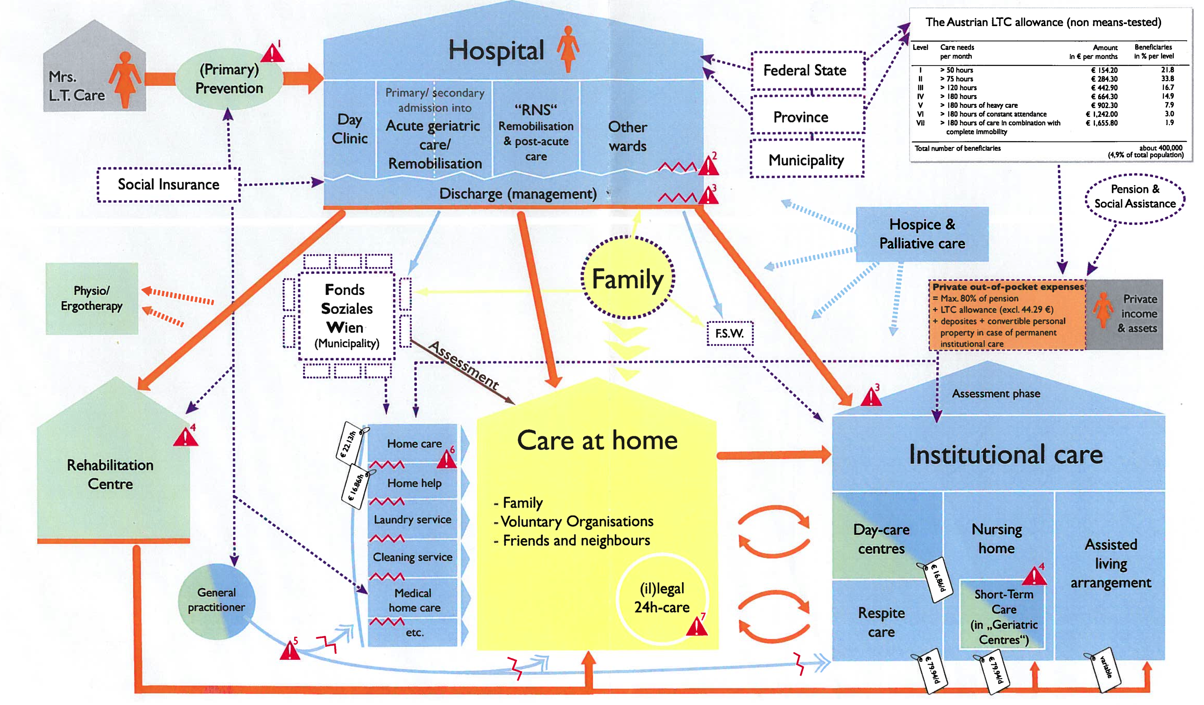
So how do we get from a fragmented, highly complex system without clear governance and accountability…
Public health
Hospitals
Primary care
Diagnosis
Treatment
Palliative
Rehab
Pharmacies
Rehabilitation Centre
Home care
Community and social care
Primary care
Source: Pathways for long-term care provision in Austria, Interlinks, European Centre 2009
Notes:
Link to previous slide: Answering this calls first for a reflection on most simply the question on what is health services delivery?
This figure here is taken from a visualization of long-term care services in Austria. As a modeling of services delivery it’s a very useful representation of what the individual’s experience with the service delivery system may look like. While which way they go and in what order may differ– fundamentally, the function of services delivery comes down to the services that are provided (click) – and we must recognize this begins even before diagnosis and includes public health, preventive measures – and (click) the settings of care where services are realized – whether it be primary care, hospitals, rehabilitation centres, and even community pharmacies.
[click] but talking about services and settings only answers how the service delivery function is observed. That then begs the question, how are services optimized?
Key points:
Service delivery function in is observed as (1) the services provided and (2) the settings where this takes place

Slide 16
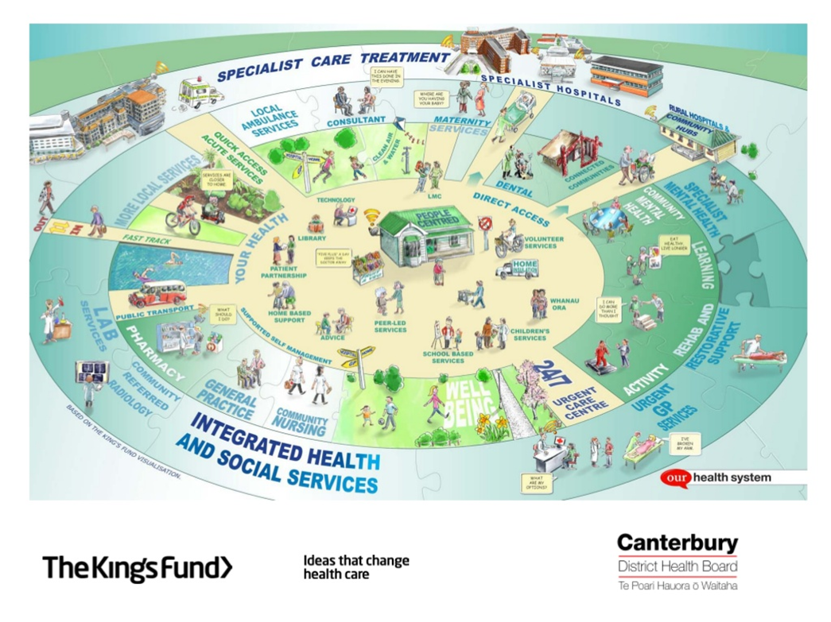
…to integrated system, where people and systems talk to each other?
Approx. 600.000 inhabitants
Notes:
Atención Integrada significa “cuidados coordinados alrededor de las personas”

Slide 17
Frameworks and key principles of integrated care
Notes:
Short intro of each participant on what integrated care is to them, according to their professional background/setting/country of origin…
Main achievements and biggest challenges again in their context.
Participants from the same country should add to each others’ stories.

Slide 18
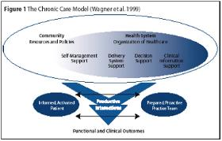
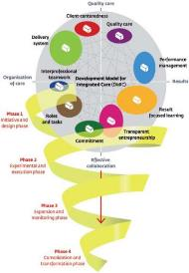
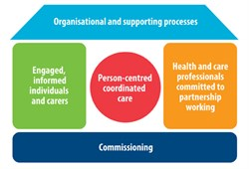
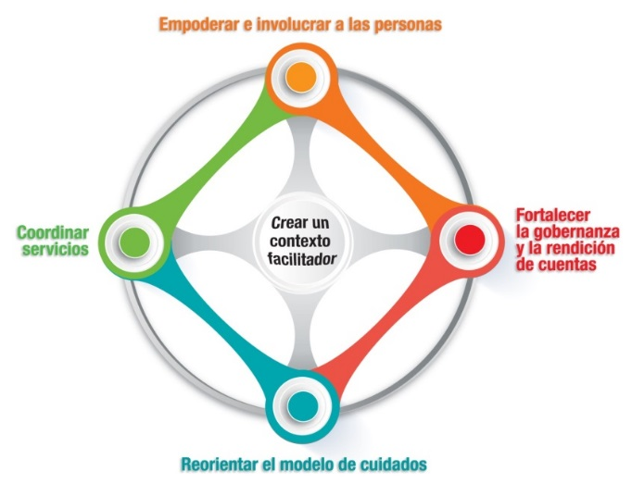
Many Frameworks Have Been Developed to Understand the Key Elements for Successful Integrated Care

Slide 19
Shortell’s Essential Features of an
Integrated Delivery System
Key messages:
focus on clinical integration
the development of payment mechanisms designed to increase greater inter-dependency of hospitals and physicians;
the modification or removal of several regulatory barriers to greater clinical integration; and
the establishment of a more robust data collection and reporting system to increase transparency and accountability.

Slide 20
The WHO European Framework for Action on Integrated Health Services Delivery
WHO Europe 2016
http://www.euro.who.int/en/health-topics/Health-systems/health-services-delivery/publications/2016/the-european-framework-for-action-on-integrated-health-services-delivery-an-overview-2016

Slide 21
Seven Key Lessons for
Service Delivery
Theme | Characteristics
1 Population-health management | The ability to have an in-depth understanding of the health needs of communities supported through data that can provide intelligence on the priorities that should be addressed
2 Primary and secondary care prevention | The ability to support people to live better with their conditions, for example through educational programmes or self-care support
3 Personalised care co-ordination | The ability to plan and co-ordinate services effectively around people’s needs helps to overcome fragmentations and improve care experiences ad outcomes
4 Effective ICT systems | Care professionals must be able to communicate well with each other and people must be able to interact effectively with care providers in a way that supports shared decision-making.
5 An integrated delivery system | Care systems need to be responsive to people’s needs, especially during times of crisis. The inability of provider networks to respond in real-time means that care co-ordination efforts are undermined.
6 Building social capital and collaborative capacity | Promoting shared values and understanding can help provide the necessary commitment to take integrated care forward.
7 Research and evaluation | Measuring, monitoring and responding to evidence to judge or benchmark care quality and outcomes is essential to improving quality of care through integration
Goodwin 2015

Slide 22
The Need for More Evidence
Systematic review looked at impact on utilisation, cost effectiveness and expenditure across 19 studies:
Range of population groups (but not multiple morbidity)
Not ‘explicit’ on nature of integrated care
Different focus of ‘type’ of approach – e.g. horizontal and vertical
Most focused on hospital utilisation through (re)admissions, lengths of stay and ED visits
Cost reduction is reported, but scale of results difficult to determine as not always quantified and mostly without controls
Evidence on cost-effectiveness poor
Heterogeneous nature of complex service innovations mean that few conclusions can be drawn

Slide 23
So what does it need to create sustainable integrated care?
Notes:
Short intro of each participant on what integrated care is to them, according to their professional background/setting/country of origin…
Main achievements and biggest challenges again in their context.
Participants from the same country should add to each others’ stories.

Slide 24
Integrated care is a concept centred around the needs of service users
‘The patient’s perspective is at the heart of any discussion about integrated care. Achieving integrated care requires those involved with planning and providing services to ‘impose the patient’s perspective as the organising principle of service delivery’
(Shaw et al, 2011, after Lloyd and Wait, 2005)

Slide 25
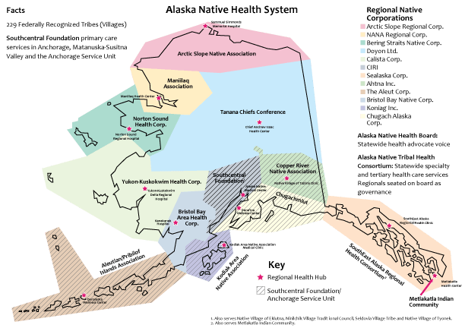

Community Engagement
Nuka Health System, Alaska
Mission:
Working together with the Native Community to achieve wellness through integration if health and other services
Vision:
A Native Community that enjoys physical, mental, emotional and spiritual wellbeing
Key approach:
Shared responsibility, commitment to quality, family wellness
“Consumer-owners”

Slide 26
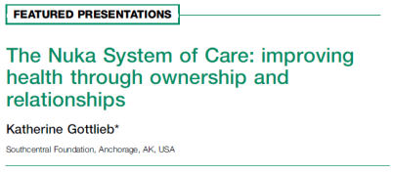
Alaskan Native leadership has ownership and management of care system since 1997
60000 people south of Anchorage and spread across 1800km of land and islands
Range of services including:
  inter-disciplinary primary care,
  dentistry and optometry,
  behavioural health,
  patient education and peer2peer health promotion
  home care – case management
  telehealth with self-management of chronic illness
Focus on rights and responsibilities approach
Some results since 1996-present:
95% enrolled in primary care, up from 35%
Same day access for routine appointment, down from 4 weeks
Waiting list for behavioural health consultation eliminated
36% reduction in hospital days
42% reduction in ER
58% reduction in specialist clinics
High patient satisfaction with respect to culture and traditions
Staff turnover reduced by 75%

Slide 27
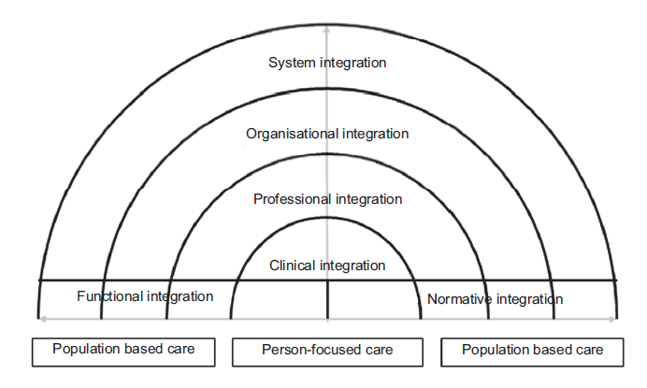
The ‚Rainbow Model‘:
Interventions on all levels
Valentijn P et al (2015) Towards an international taxonomy of integrated primary care: a Delphi consensus approach. BMC Fam Pract, 16(1):64-015-0278-x

Slide 28
It needs senior leadership and a top-down/bottom-up approach
TOP- DOWN
STANDARIZABLE INTERVENTIONS
ELECTRONIC
MEDICAL
RECORD
FINANCING AND
JOINT COMMISSIONING
CALL CENTER
ELECTRONIC
PRESCRIPTION
STRATIFICATION
BOTTOM UP
LOCAL INNOVATION
CASE
NURSING
INTEGRATED
CARE
PATIENT
EMPOWERMENT
SUBACUTE
CENTRES
HEALTH AND SOCIAL CARE COORDINATION
Bengoa, Mota 2013

Slide 29
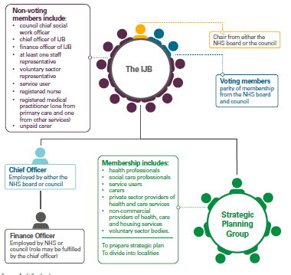
Scotland: Integration Joint Boards

Slide 30
Different cultures, organisations and work ethics
Community
Control
Formal board
Administrative hierarchy
Professional chimneys
Operating workflow
Cure
Care
Adapted from Glouberman/Mintzberg 2001

Slide 31
Changing cultures and strengthening competencies in Canterbury, NZ
Common goals
Consistent leadership
Engagement – of professionals and communities
Quality improvement, not cost containment
Developing skills and capacity
Robust primary care – Pegasus Health
Focus on care transitions
Focus on care at home
Information systems to support communication and used to drive quality improvement
Effective learning strategies
Long-term view
Professional cultures that support team work
  “One System, One Budget”
Timmins & Ham, 2013 - http://www.kingsfund.org.uk/publications/quest-integrated-health-and-social-care
Notes:
Atención Integrada significa “cuidados coordinados alrededor de las personas”

Slide 32
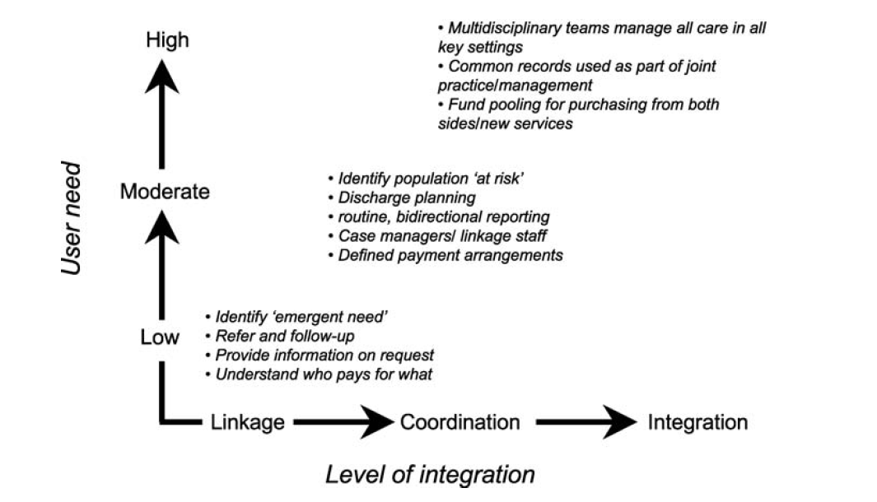
Setting the level of integration against user need to optimise care
Source: adapted from Leutz 1999 in Nolte & McKee (2008)

Slide 33

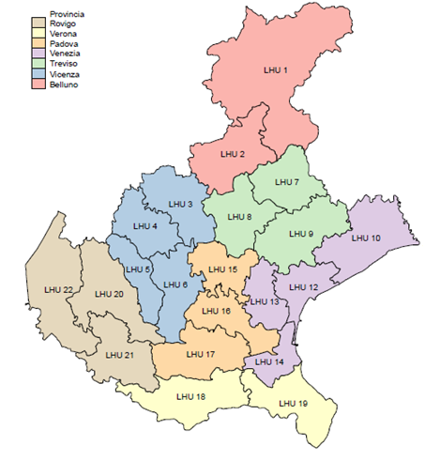
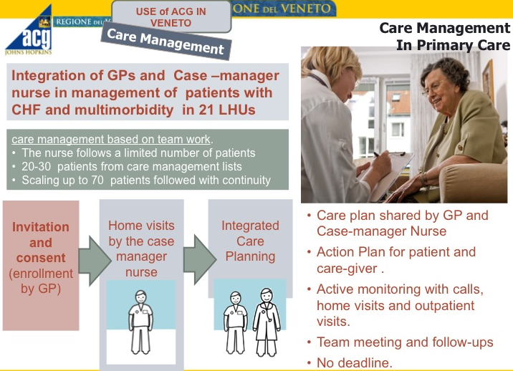
Adjusted clinical groups©, Veneto Region, Italy
Pilot project started in 2012 with 2 local health units, roll-out continued until 2015
Construction of database, retrospective analysis of population, identification of risk groups and gaps analysis lead to:
Almost 5 mio inhabitants
Based on Corti MC. USING A POPULATION RISK-ADJUSTEMENT TOOL TO INTEGRATE HEALTH SERVICE DELIVERY IN REGIONE VENETO. Presentation during Second CIHSD Technical Meeting of the WHO Regional Office for Europe. Istanbul 2015

Slide 34
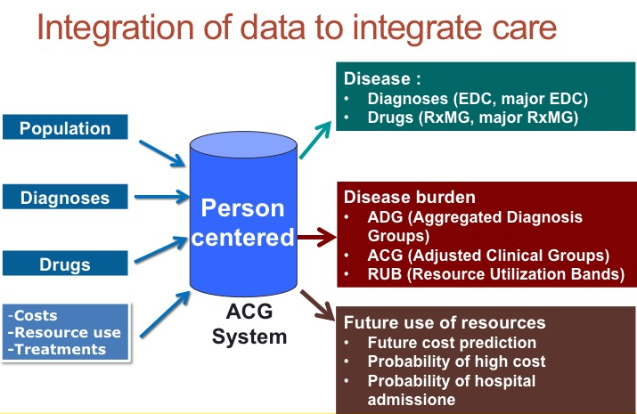
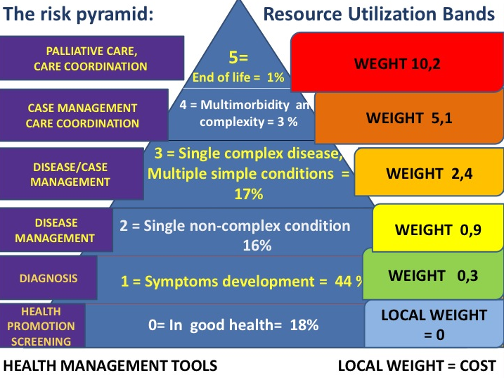
Key Lessons: population health management does not work without data analysis
Align all available data sets
Invest in data quality
Use predictive modelling
Concentrate on quality improvement of service delivery NOT cost reduction
Based on Corti MC. USING A POPULATION RISK-ADJUSTEMENT TOOL TO INTEGRATE HEALTH SERVICE DELIVERY IN REGIONE VENETO. Presentation during Second CIHSD Technical Meeting of the WHO Regional Office for Europe. Istanbul 2015

Slide 35
Practical examples of integrated care from Europe
Notes:
Short intro of each participant on what integrated care is to them, according to their professional background/setting/country of origin…
Main achievements and biggest challenges again in their context.
Participants from the same country should add to each others’ stories.

Slide 36

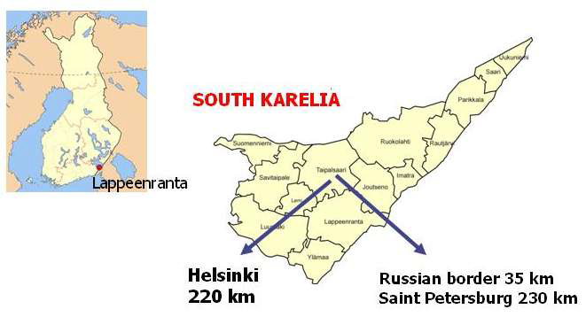
South Karelia, Finland: providing holistic care in rural and remote areas
Eksote was founded in 2010 to provide necessary holistic care to the133,000 citizens of 9 rural, remote and resource-poor districts in Southern Finland.
Eksote has a contract of services with each district according to the specific need of the local population.
http://www.eksote.fi/sites/eng/Sivut/default.aspx

Slide 37

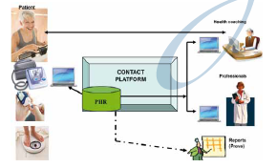
South Karelia, Finland: supporting people to support themselves
Established integrated organisation in 2010 combining primary/secondary care with elderly/social care
Goal was equal access across a rural municipality
Focus on prevention and citizen responsibility in own care
Remote monitoring and health coaching
Mobile health units – use of webcams, broadband and video phones
Pilot phase had 185 patients
Care team was a GP, 2 FTE nurses, part-time home care workers, IT engineers and data analysts
Patients felt less isolated and more secure
Medication use reduced
Remote consultations reduced costs by 50% compared to usual care
Reduced travelling to appointments
Health coaches and an electronic database support the planning of care and monitoring of the health status
View the project at: https://www.youtube.com/watch?v=9VAiEeODspI

Slide 38
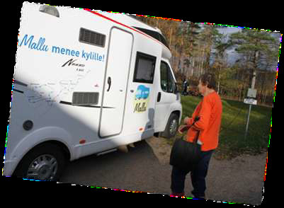
Mallu – Mobile Health Clinic
Established in November 2011
Acts as a nurse-led mobile clinic to rural villages throughout Eksote
Works in cooperation with village associations
Electronic patient record
Includes:
  Nurse consultation
  Health counselling
  Regular health checks
  Treating wounds
  Capillary blood work analysis (e.g. glucose)
  Vaccinations and medicines
  Dental care (since 2013)
  Physiotherapy

Slide 39
Eksote: key elements and continuous innovation
Village associations have a key part to play to promote health and wellbeing and prevent social and medical problems – e.g. themed events for the hard of hearing and with various sports federations.
The recent refugee crisis prompted a new service to help immigrants with language, culture, religion and health and social services.
Newest project: collaboration with Posti provides home assistance while delivering your mail.
http://www.eksote.fi/sites/eng/Sivut/default.aspx

Slide 40

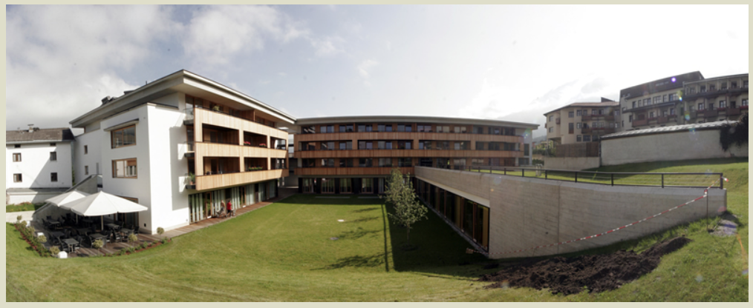
The House of Generations, Austria
“A meeting point for everyone in Schwaz”
In 2007, the House of Generations concept was jointly developed by Caritas and the local municipality of Schwaz.
In 2010 the House was opened and the first tennants and services moved in.
The governing body now consists of the regional government of Tyrol, the city council of Schwaz, Caritas, and a private foundation called “Frieden” (peace in German).

Slide 41
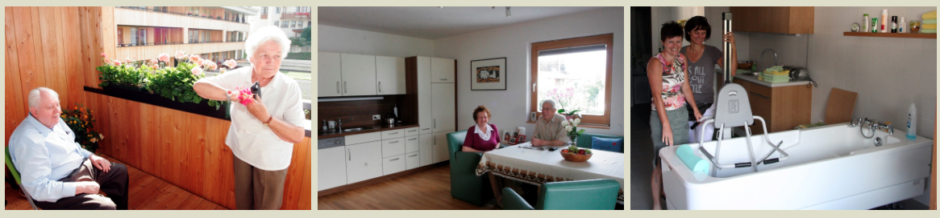
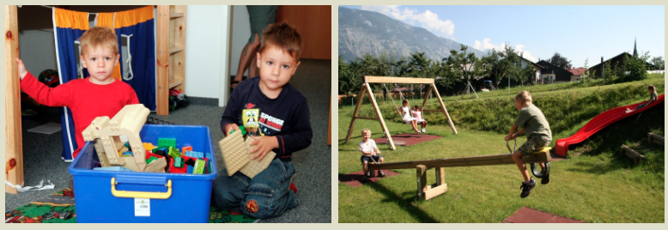
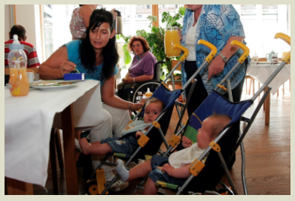
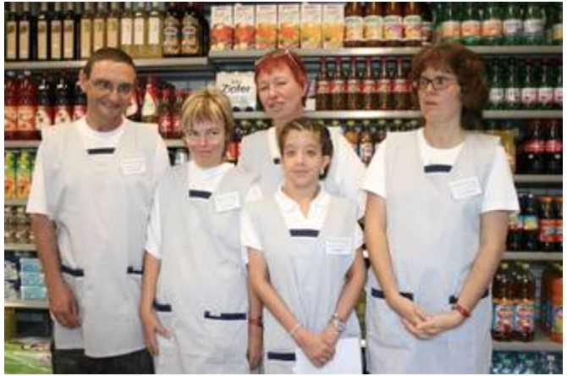
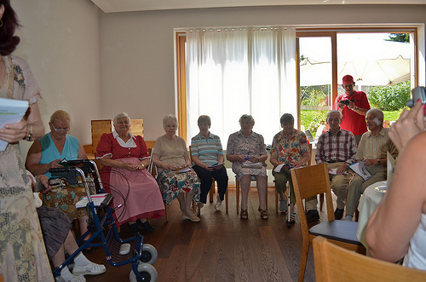
Services and organisations on site
Wellbeing bath
Living
Assisted living
Shared apartment for people with disabilities
Apartments for young families
Life
Social services
Respite care
After school care and child daycare centre
Meeting room
Restaurant
Village shop
Support for families
Computeria
Grannies to lend

Slide 42
The House of Generations grows: key elements and success factors
The vision is to provide integrated living for people young and old, disabled or healthy. The House has an open doors policy and has become a vital part and meeting point for the town. It is used by local clubs, for family celebrations and as a vocational training centre.
One key success factor is the co-location of so many different health, social services and community services under one roof and a close collaboration among all service providers in the municipality.
The house manager is very actively engaging the people and inviting new ideas and services to add to the spirit of the big family.
It is managed independently and needs to be financially viable, which enabled simple and creative solutions, but also supports the sense of self-sufficiency rather than dependence.
A key element in all activities is the belief that every person has valuable skills and talents, from which the community can profit.
WHO Regional Office for Europe. Lessons from transforming health services delivery:
Compendium of initiatives in the WHO European Region. WHO, Copenhagen 2016

Slide 43
SELFIE: Sustainable intEgrated care modeLs for multi- morbidity: delivery, FInancing and performancE
17 programmes:
‒ frail elderly, palliative patients/ oncology patients, persons with problems in multiple life domains, whole populations
‒ Scope: small-scale case finding, screening, regional approaches, population health management
‒ Focus: prevention, crossing health- and social care, palliative care, transfer care
www.selfie2020.eu

Slide 44
WP2: Comprehensive description of the most promising IC models for multi-morbidity
Themes that emerged in overarching analysis:
Holistic approach, i.e. social aspect, mental health
Continuity of care, i.e. importance of single contact point
Client involvement, i.e. shared decision making
Informal caregiver involvement
Self management as means of empowerment
Relationship between professionals, i.e. importance of communication

Slide 45
WP3: Exploring different financial and payment schemes applied across integrated care programmes for multi-morbidity

Slide 46
WP3: Exploring different financial and payment schemes applied across integrated care programmes for multi-morbidity
Programme-level incentives

Slide 47
Transformational change needs to happen throughout society
Notes:
Short intro of each participant on what integrated care is to them, according to their professional background/setting/country of origin…
Main achievements and biggest challenges again in their context.
Participants from the same country should add to each others’ stories.

Slide 48
The WHO European Region:
53 Member States – 900 Mio inhabitants
10 Lessons learned from 85 cases across the Region
Put people and their needs first
Reorient the model of care
Reorganize the delivery of services
Engage patients, their families and carers
Rearrange accountability mechanisms
Align incentives
Develop human resources for health
Uptake innovations
Partner with other sectors and civil society
Manage change strategically
WHO Regional Office for Europe. Lessons from transforming health services delivery:
Compendium of initiatives in the WHO European Region. WHO, Copenhagen 2016

Slide 49
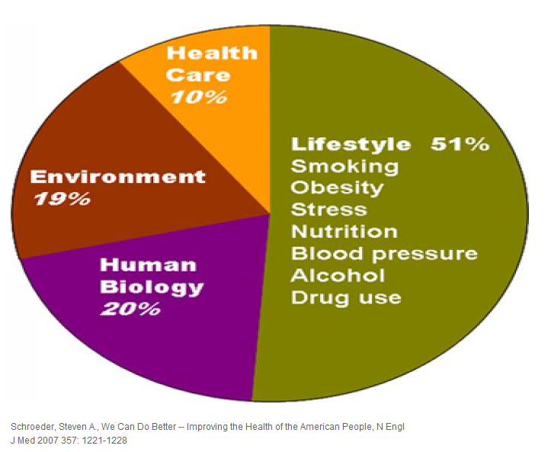
Focus on holistic approach to health and wellbeing
Notes:
Everyone in this room is concerned with improving population health but we have traditionally focused on health care’s ability to achieve that goal. This chart shows the small proportion of population health that can be accounted for by health care.
Need to expand what we think about addressing when we talk about improving population health

Slide 50
Whole-of systems and health in all policies approach for integrated care
CONTEXT
Epidemiology, cultural, socio-demographic and economic
Management of health services • Models of care
Organization of providers • Continuous performance improvement
Universal • Equitable • People-centred • Coordinated/integrated health services
SERVICES
DELIVERY
HEALTH SYSTEM
Governance, financing and workforce
Improved health (level and equity)
OTHER SECTORS
Education, sanitation, social assistance, labor, housing, environment, others
FAMILIES
COMMUNITIES
PERSON
Source: Adapted from WHO-HQ Global Strategy on people-centred and integrated health services 2015

Slide 51


Culture of a Learning Healthcare System Builds Value
Common Vision
Clinical Work Processes
Data and Evaluation Transparency

Slide 52
To conclude
“I can plan my care with people who work together to understand me and my carer(s), allow me control, and bring together services to achieve the outcomes important to me.”
National Voices 2013
K. Viktoria Stein, PhD
Head of the Integrated Care Academy©
International Foundation for Integrated Care
viktoriastein@integratedcarefoundation.org
www.integratedcarefoundation.org

